Slide 1




Natural Language Processing
Maxime Sazadaly
maxime.sazadaly@ubisoft.com

Slide 2



Quick intro
Maxime Sazadaly
Former ESIEA student - 2018
Technical Lead – Machine Learning Engineering
Multiple internships in school laboratories
Ubisoft Paris Studio
Machine Learning / Data Science specialization
Line of work: topic modeling, toxicity detection, large language models
Very few resources on NLP back then

Slide 3
Course objectives
Goals
Highlight specificities and caveats of working with an unusual type of data: ordered symbols.
Digest NLP’s history while introducing its main algorithms and paradigms.
Efficiently visualize and leverage outputs of those algorithms.

Slide 4
Course objectives
Goals
R&D
Operational
Highlight specificities and caveats of working with an unusual type of data: ordered symbols.
Digest NLP’s history while introducing its main algorithms and paradigms.
Efficiently visualize and leverage outputs of those algorithms.

Slide 5
Course coverage
Given the number of hours available, this course will cover 3 main areas:
NLP applications showcase
Text representation methodologies
Text classification & clustering

Slide 6

COURSE SUMMARY
I. NATURAL LANG-WHAT?
II. TEXT REPRESENTATION 101
III. LANGUAGE MODELS
IV. NLP DATA PIPELINE
V. VISUALIZATION
TD
TD

Slide 7

PART 1 NATURAL LANG-WHAT?

Slide 8
NLU/NLP DEFINITION
Natural Language Processing
Subfield of linguistics, computer science, information engineering and artificial intelligence concerned with the interactions between computers and human languages.
Source: Wikipedia

Slide 9
NLU/NLP DEFINITION
Natural Language Understanding
Subtopic of natural-language processing in artificial intelligence that deals with machine reading comprehension.
Source: Wikipedia

Slide 10
NLU/NLP DEFINITION
In this course…
Natural Language {Something}
Relates to any machine learning / statistical model system that aims to modelize any ordered sequence of symbols or extract knowledge from it.
Source: myself

Slide 11
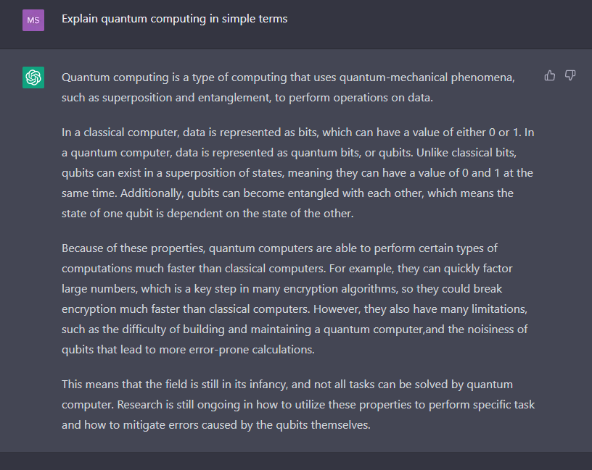
WHAT IS IT USEFUL FOR?
Text generation

Slide 12

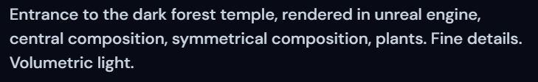
WHAT IS IT USEFUL FOR?
Image generation

Slide 13
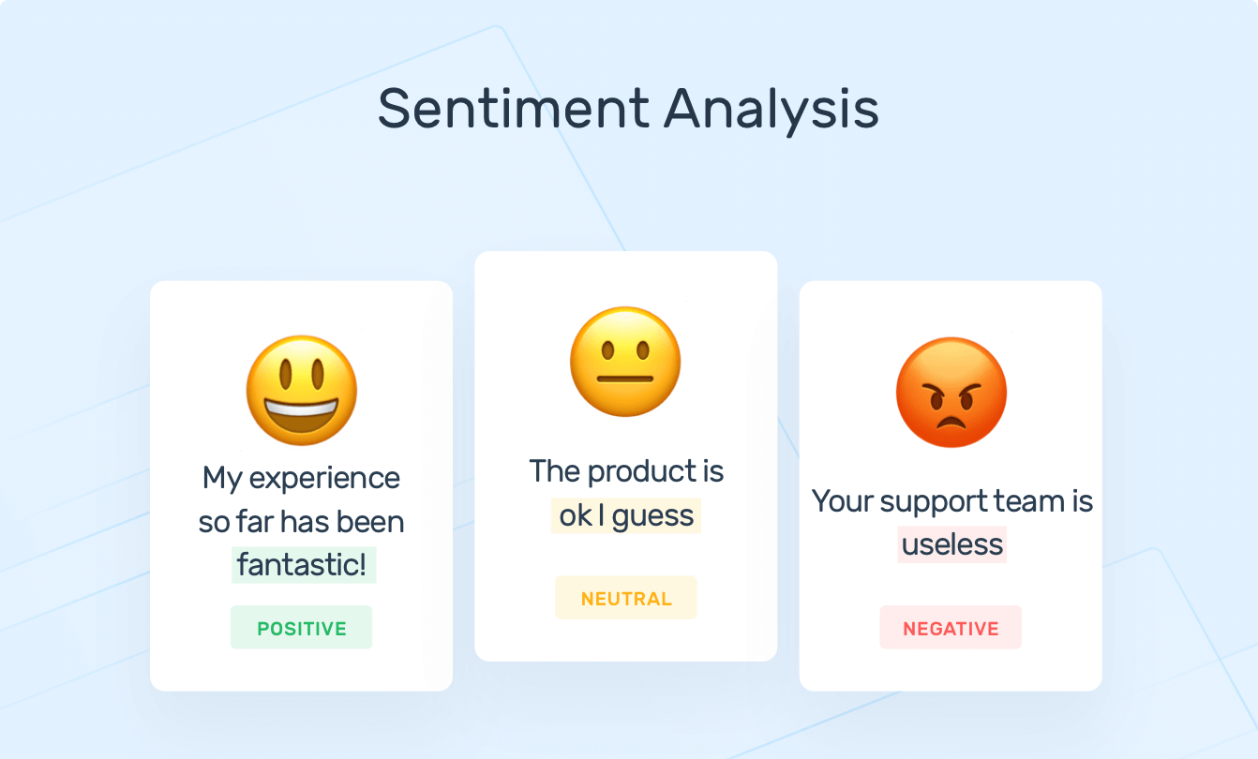
WHAT IS IT USEFUL FOR?
Text Classification
MonkeyLearn

Slide 14
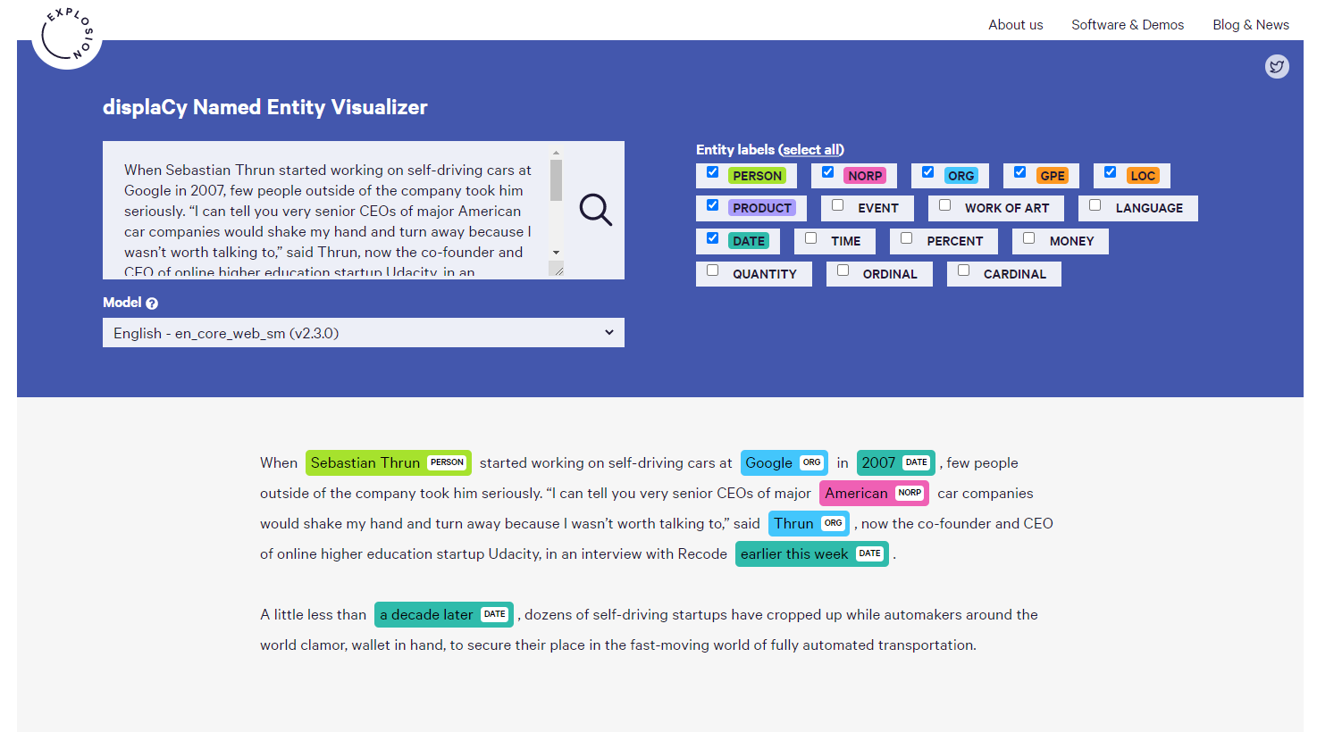
WHAT IS IT USEFUL FOR?
Named Entity Recognition

Slide 15
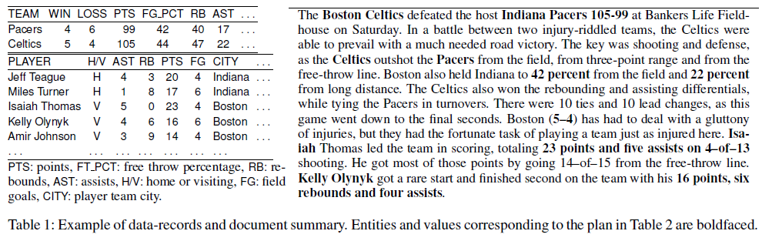
WHAT IS IT USEFUL FOR?
Data to Text Generation

Slide 16
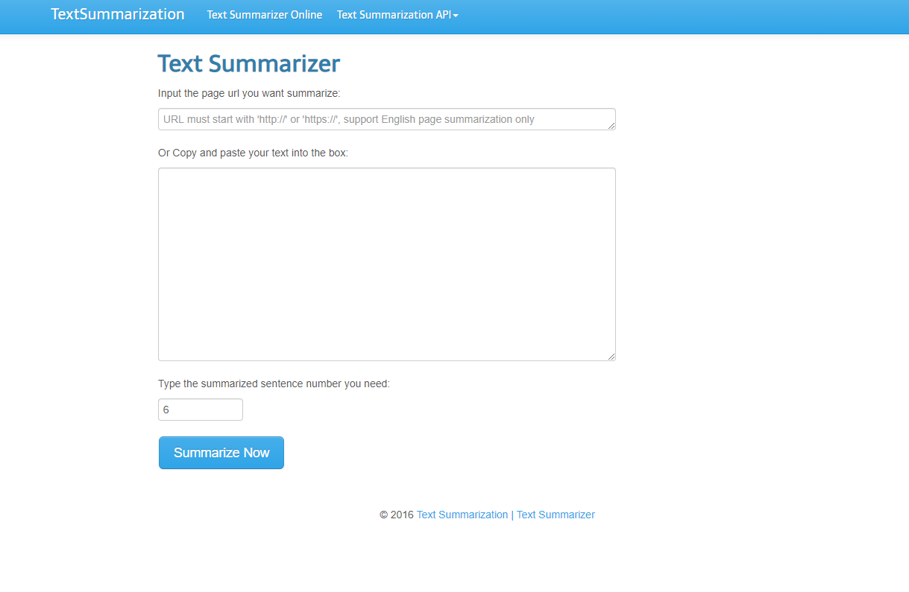
WHAT IS IT USEFUL FOR?
Text Summarization

Slide 17
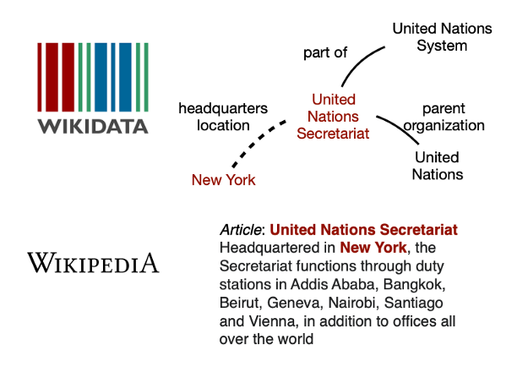
WHAT IS IT USEFUL FOR?
Knowledge graph
Pahuja et al

Slide 18

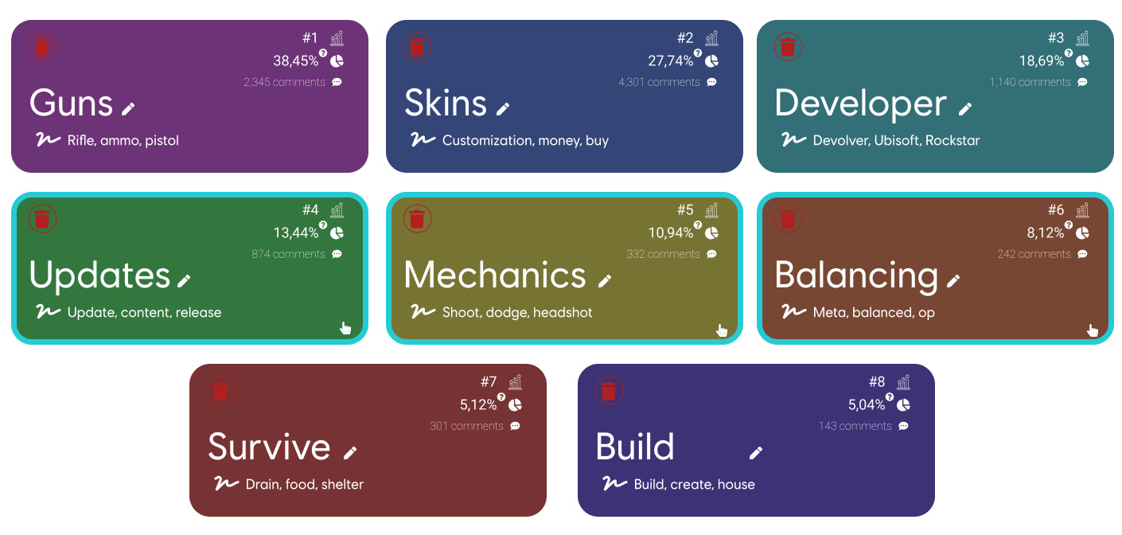
WHAT IS IT USEFUL FOR?
Topic Modeling

Slide 19
USE CASES TAXONOMY
Content creation
Knowledge extraction
Given an input of any kind (textual or not), content creation models create new elements related to. To be considered a NLP system, either the input or output must contain textual data at some point.
Given an input containing texts, knowledge inference models retrieve specific characteristics from the input to gain a better understand of the texts’ content.

Slide 20
HOW IS IT DONE?
Clustering models
Classification models
Generative models
Encoder / Decoder
Bayesian methods
Weak supervised learning
Active learning
Reinforcement learning

Slide 21
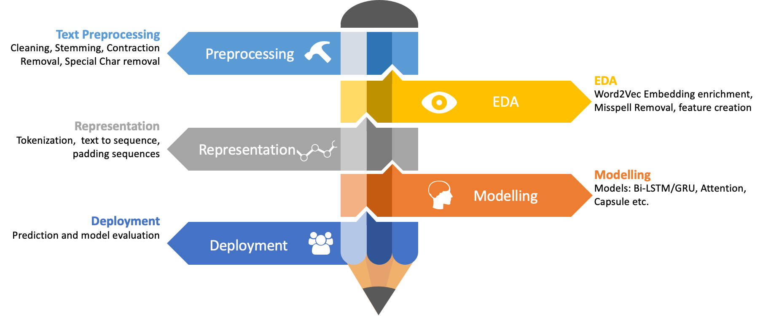
WHAT DOES A TYPICAL NLP PROJECT LOOK LIKE?
https://mlwhiz.com/blog/2019/01/17/deeplearning_nlp_preprocess/

Slide 22
Section key takeaways
Natural Language Processing in machine learning regroups all the algorithms dedicated to the analysis of interactions between humans and computers. Usually, however, it implicitly refers to texts.
One of the main task of all NLP systems it to create meaningful mathematical representations of words so that algorithms can be applied on texts.
To be proficient in NLP, one need to master lots of different ML subdomains, such as classification systems, clustering systems, Bayesian statistics, generative models, etc.

Slide 23
Section key takeaways
A typical NLP project will be similar to a classic ML problem, with three major twists: how is data preprocessed, mathematically represented and visualized

Slide 24

PART 2 TEXT REPRESENTATION 101

Slide 25
Disclaimer Given the few hours of this course, we won’t have time to deep dive into each individual algorithm behaviour. Only 5 of them will be covered: Word2Vec, ELMo, The Transformer, BERT and DistilBERT. If you have any question regarding other models / approaches mentionned, feel free to reach out to me!

Slide 26
CLASSICAL ML VS NLP
ID | DATE | L_PEAK | R_PEAK | FREQUENCY | ANOMALY
85XB4Y8F33 | 10/12/2018 | -53 | 5.2 | 133 | TRUE
UK3JR1O0RU | 23/02/2019 | -33.1 | 3.8 | 276 | FALSE
B31XA8O3KO | 14/11/2019 | -32.7 | 14.5 | 76 | TRUE
LTV6LMSZVG | 11/8/2017 | -81.9 | 83.2 | 142 | TRUE
R4IVRK5CCB | 11/1/2017 | -21.3 | 4.6 | 56 | FALSE
NKCQJDNUII | 18/09/2020 | -0.4 | 1 | 83 | FALSE
DATE | CONTENT | RATING
2/1/2019 | Pls make it th13 | 3
2/1/2019 | it is cute | 5
2/1/2019 | superb | 5
2/1/2019 | its an awesome game, period | 5
2/1/2019 | wow | 5
Typical ML Dataset
Typical NLP Dataset
Numerical values
Ordinal values
??? (looks a bit like ordinal values)

Slide 27
THE MAIN NLP PROBLEM
How do we feed text to a ML algorithm?
Text is by essence non-numerical. If we want to apply machine learning methods on it (other than frequency based methods), we have to convert it to a numerical representation first.
Ideal representations should handle semantic, polysemy, irony and lots of other specificities of texts.
We’re not fully there yet, but tremendous progress has been made in the last two decades.

Slide 28
TEXT REPRESENTATION APPROACHES
Most performant
Frequency based
Neural network based
Leverage the occurrences of words across your text corpus to produce vector representations that will expose documents’ most important words, i.e. representations that don’t give importance to stopwords.
Representations issued by such systems don’t take word meaning into account, but are extremely easy to create, making them quite good for NLP tasks that aren’t dependent of semantic.
Build neural networks with various objective tasks to retrieve vector representations that will inherently contain the semantic of words, i.e. their actual meaning.
Representations issued by such systems don’t identify the importance of specific words in a corpus, but have shown to be the most performant systems for a wide variety of complex NLP tasks.

Slide 29
TEXT REPRESENTATION APPROACHES
Most expensive
Frequency based
Neural network based
Leverage the occurrences of words across your text corpus to produce vector representations that will expose documents’ most important words, i.e. representations that don’t give importance to stopwords.
Representations issued by such systems don’t take word meaning into account, but are extremely easy to create, making them quite good for NLP tasks that aren’t dependent of semantic.
Build neural networks with various objective tasks to retrieve vector representations that will inherently contain the semantic of words, i.e. their actual meaning.
Representations issued by such systems don’t identify the importance of specific words in a corpus, but have shown to be the most performant systems for a wide variety of complex NLP tasks.

Slide 30

METHODOLOGIES TIMELINE
1960+
Dummy encoding

Slide 31
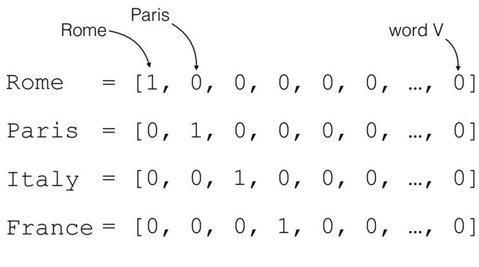
DUMMY ENCODING
Representing words with sparse vectors
Encoding each individual word of our corpus into a vector filled with 0 expect at a specific position where the value is 1 (equivalent to the encoding of categorical variables).
Once each word is encoded, we represent a document D by the concatenation of its word’s vectors, i.e. by a two dimensional vector.
Dummy encoding of words
Also called one-hot encoding

Slide 32

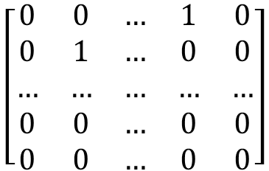
DUMMY ENCODING
The
$$\left[\begin{matrix}0 & 0 & … & 1 & 0 \\ 0 & 1 & … & 0 & 0 \\ … & … & … & … & … \\ 0 & 0 & … & 0 & 0 \\ 0 & 0 & … & 0 & 0\end{matrix}\right]$$
quick
The quick brown fox jumps over the lazy dog.
lazy
dog

Slide 33
DUMMY ENCODING
Successfully transform words and documents into numerical vectors!
However…
Word meaning should be reflected in the vector. As a result, words with similar meaning should have similar vectors
Doesn’t handle polysemy, irony, misspelling or anything similar whatsoever
Terribly inefficient in terms of storage

Slide 34
DUMMY ENCODING
NEVER. USE. IT.
If someone tells you to, he’s either a fool or a genius. Those two traits often pair well, so be careful.

Slide 35
METHODOLOGIES TIMELINE
1960+
Dummy encoding
~1980
TF-IDF

Slide 36
TERM FREQUENCY-INVERSE DOCUMENT FREQUENCY
TF-IDF
Numerical statistic measuring how much a word is important in a document considering its global usage across a text corpus.
Generally used in systems where documents need to be ranked in order to identify the most informative elements among them.
Can be used as an alternative to word count occurrences to represent documents. This is specifically done by scikit-learn.

Slide 37
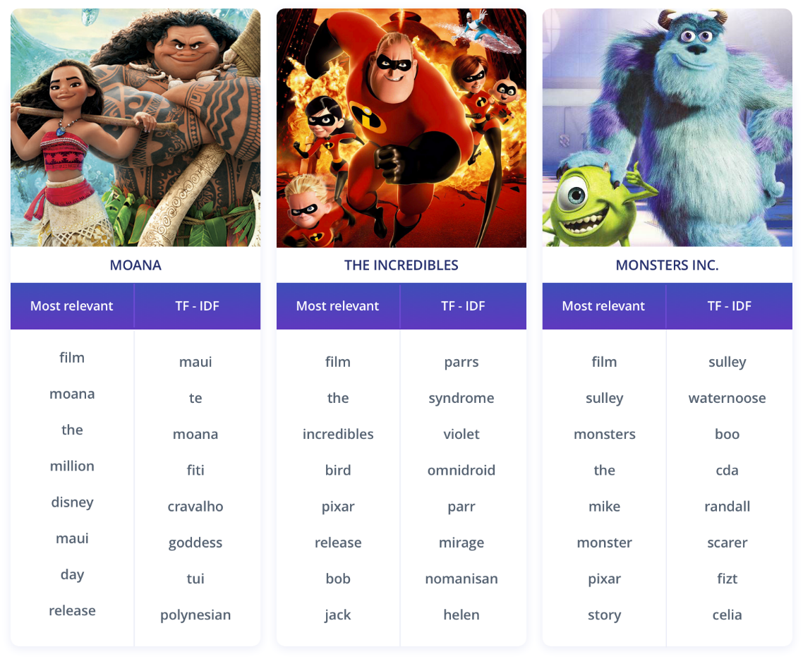
TERM FREQUENCY-INVERSE DOCUMENT FREQUENCY
TF-IDF
Comparison of most common words and TF-IDF scored words. https://www.kdnuggets.com/2018/08/wtf-tf-idf.html

Slide 38
TERM FREQUENCY-INVERSE DOCUMENT FREQUENCY
TF-IDF
If a term is widely used across all documents, its importance is limited since it isn’t specifically characteristic of a given document.
If a term is widely used in a document and not across the whole corpus, it has a high importance since it is highly characteristic of this document.

Slide 39
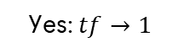
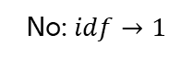
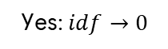


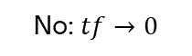
TERM FREQUENCY-INVERSE DOCUMENT FREQUENCY
TF-IDF
Product of two statistical measures, namely:
Term Frequency
Inverse Document Frequency
$$tf\left(t, d\right)$$
$$∙$$
$$idf\left(t, D\right)$$
Is term widely used in the current document?
Is term widely used across all documents?
Yes: $tf→1$
No: $tf→0$
Yes: $idf→0$
No: $idf→1$

Slide 40
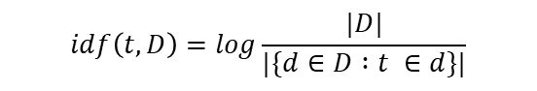
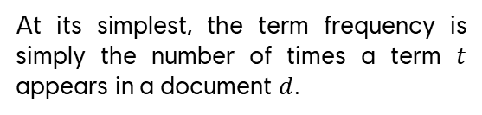
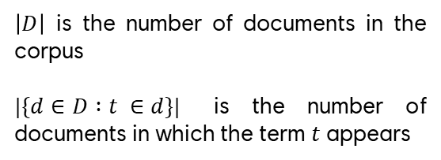
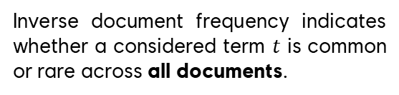
TERM FREQUENCY-INVERSE DOCUMENT FREQUENCY
TF-IDF
Product of two statistical measures, namely:
Term Frequency
Inverse Document Frequency
At its simplest, the term frequency is simply the number of times a term $t$ appears in a document $d$.
Inverse document frequency indicates whether a considered term $t$ is common or rare across all documents.
$$tf\left(t, d\right)=f_{t, d}$$
$$idf\left(t, D\right)=log\frac{|D|}{|\{d∈D :t ∈d\}|}$$
For specific reasons, this measure is sometimes inefficient (e.g. long documents). Such frequencies can be weighted in many different fashions.
$\left|D\right|$ is the number of documents in the corpus
$|\{d∈D :t ∈d\}|$ is the number of documents in which the term $t$ appears

Slide 41
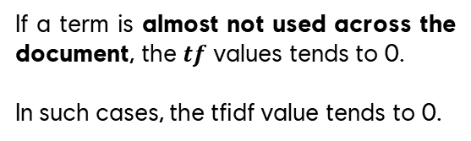
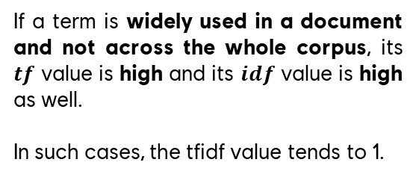

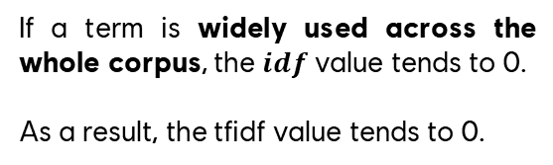
TERM FREQUENCY-INVERSE DOCUMENT FREQUENCY
TF-IDF
Product of two statistical measures, namely:
Term Frequency
Inverse Document Frequency
$$tfidf\left(t, d, D\right)=tf\left(t,d\right)∙idf(t,D)$$
If a term is widely used in a document and not across the whole corpus, its $tf$ value is high and its $idf$ value is high as well.
In such cases, the tfidf value tends to 1.
If a term is almost not used across the document, the $tf$ values tends to 0.
In such cases, the tfidf value tends to 0.
If a term is widely used across the whole corpus, the $idf$ value tends to 0.
As a result, the tfidf value tends to 0.

Slide 42
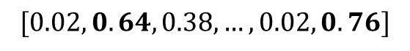
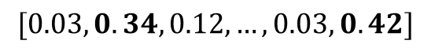
TERM FREQUENCY-INVERSE DOCUMENT FREQUENCY
In a corpus talking about computer…
An ethernet connection is generally faster than WiFi
$$[0.03, 0.34,0.12,…,0.03, 0.42]$$
In a corpus talking about hobbies…
An ethernet connection is generally faster than WiFi
$$[0.02, 0.64, 0.38,…,0.02, 0.76]$$

Slide 43
METHODOLOGIES TIMELINE
1960+
Dummy encoding
~1980
TF-IDF
2001
Vanilla Neural Networks

Slide 44
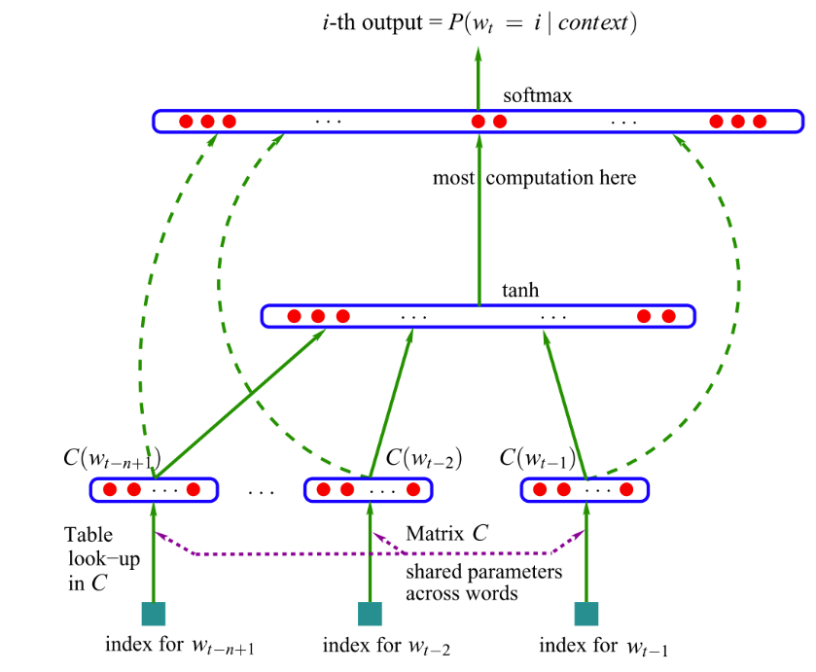
VANILLA NEURAL NETWORKS
First « language model »: feed-forward neural network predicting the next word in a sentence.
Completely unsupervised system since no label has to be created.
Last layer weigths are used as vector representation of the word to be predicted. Its values are no longer 0/1, but actual float values. Called the embbeding layer.
Used in smart keyboards (prediction of next typed words)
Bengio et al., 2001

Slide 45
VANILLA NEURAL NETWORKS
learning
[0.25, -0.12, … , 0.89, 0.108]
learn
[0.22, -0.04, … , 0.84, 0.92]
Bengio et al., 2001

Slide 46
VANILLA NEURAL NETWORKS
Successfully transform words into vector representations that take word semantic into account!
However…
Not especially easy to train since documents (i.e. group of sentences) can be very long, hence hard convergence
Similarity between words of the corpus remain arguable
Highly tied to the dataset used

Slide 47
METHODOLOGIES TIMELINE
1960+
2008
Dummy encoding
Multi-task learning
~1980
TF-IDF
2001
Vanilla Neural Networks

Slide 48
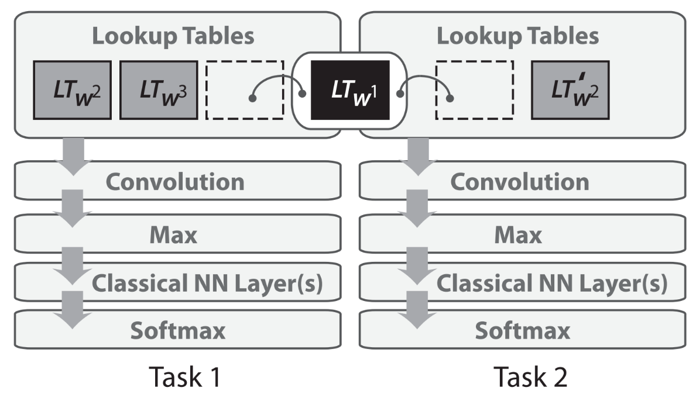
MULTI-TASK LEARNING
A common representation is shared across two networks trained on different tasks.
The lookup table can be updated by both networks.
Better understanding of low-level information, resulting in task insensitive embeddings.
Example tasks: machine translation + question answering
Collobert et al., 2008

Slide 49
METHODOLOGIES TIMELINE
1960+
2008
Dummy encoding
Multi-task learning
~1980
2013
TF-IDF
Word2Vec
2001
Vanilla Neural Networks

Slide 50
WORD2VEC
2013
Word2Vec
Philosophy
Properties and results
In-depth explanation

Slide 51
WORD2VEC
Word2Vec
Philosophy
The sense of a word is directly linked to the context in which it is used. This context is contained in the word’s surrounding, i.e. in other nearby words.
Main idea
Previously, NN learned to predict the next elements of a sentence. Now, Word2Vec learn to predict the context in which a word occurs. Plus, it only requires a single hidden layer and no activation function.
How
Mikolov et al., 2013

Slide 52
WORD2VEC
2013
Word2Vec
Philosophy
Properties and results
In-depth explanation

Slide 53
WORD2VEC
Word2Vec
Properties
Removal of multiple hidden layers
Modification of the objective task
Neural networks performances generally rise by increasing their number of hidden layers.
Previous tasks tried to predict the next word of a sentence given the words preceding it.
The enormous amount of available texts made stacking lots of layers pretty much useless in this case.
Word2Vec creators introduced two alternative methods, known as Skip-gram and C-BOW (Contextual Bag of Word).
Computation is way faster than previous methods.

Slide 54
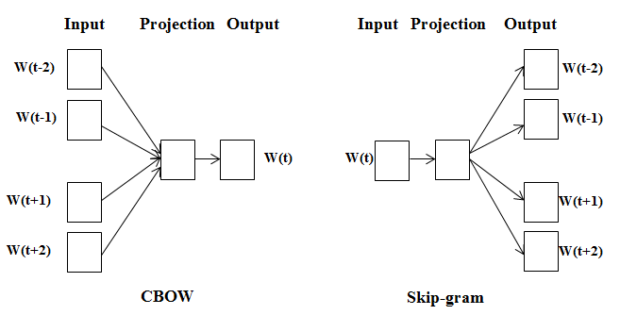
WORD2VEC
Word2Vec
Skip-gram vs C-Bow
https://www.researchgate.net/publication/319954363_Deep_Learning_Based_Technique_for_Plagiarism_Detection_in_Arabic_Texts/

Slide 55
WORD2VEC
Word2Vec
Algorithm steps (toy explanation)
Take a huge text corpus
Associate a random vector to each word
3. Go over the text with a sliding window, moving one word at a time. At each step, there is a central word and context words (other words in this window)
4. For the central word, compute probabilities of context words
5. Adjust the vectors values to increase these probabilities.
https://lena-voita.github.io/nlp_course/word_embeddings.html

Slide 56
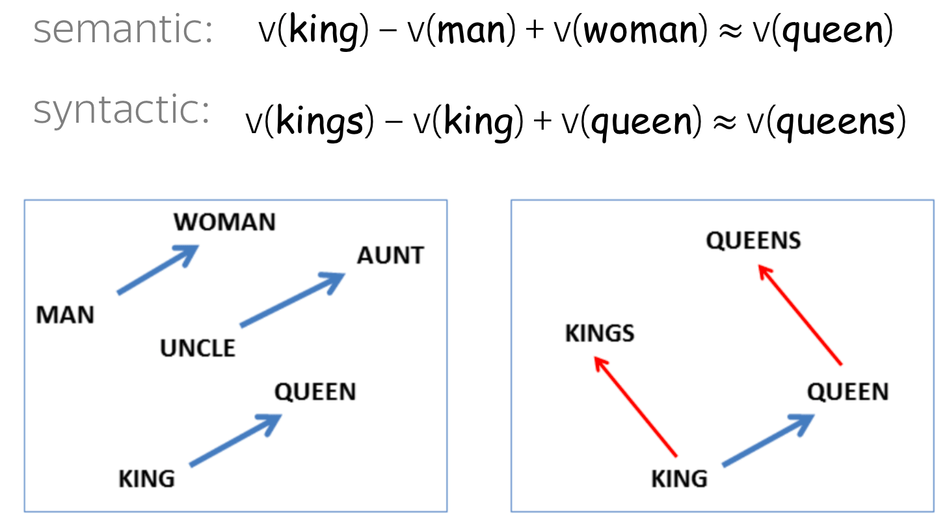
WORD2VEC
Word2Vec
Results
https://lena-voita.github.io/nlp_course/word_embeddings.html

Slide 57
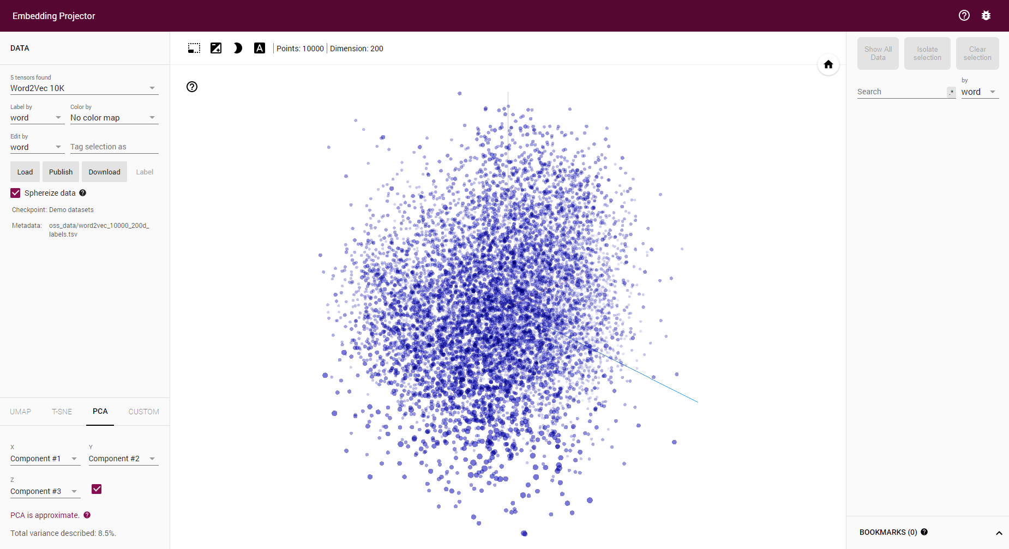
WORD2VEC
Word2Vec
Results
https://projector.tensorflow.org

Slide 58
WORD2VEC
2013
Word2Vec
Philosophy
Properties and results
In-depth explanation

Slide 59
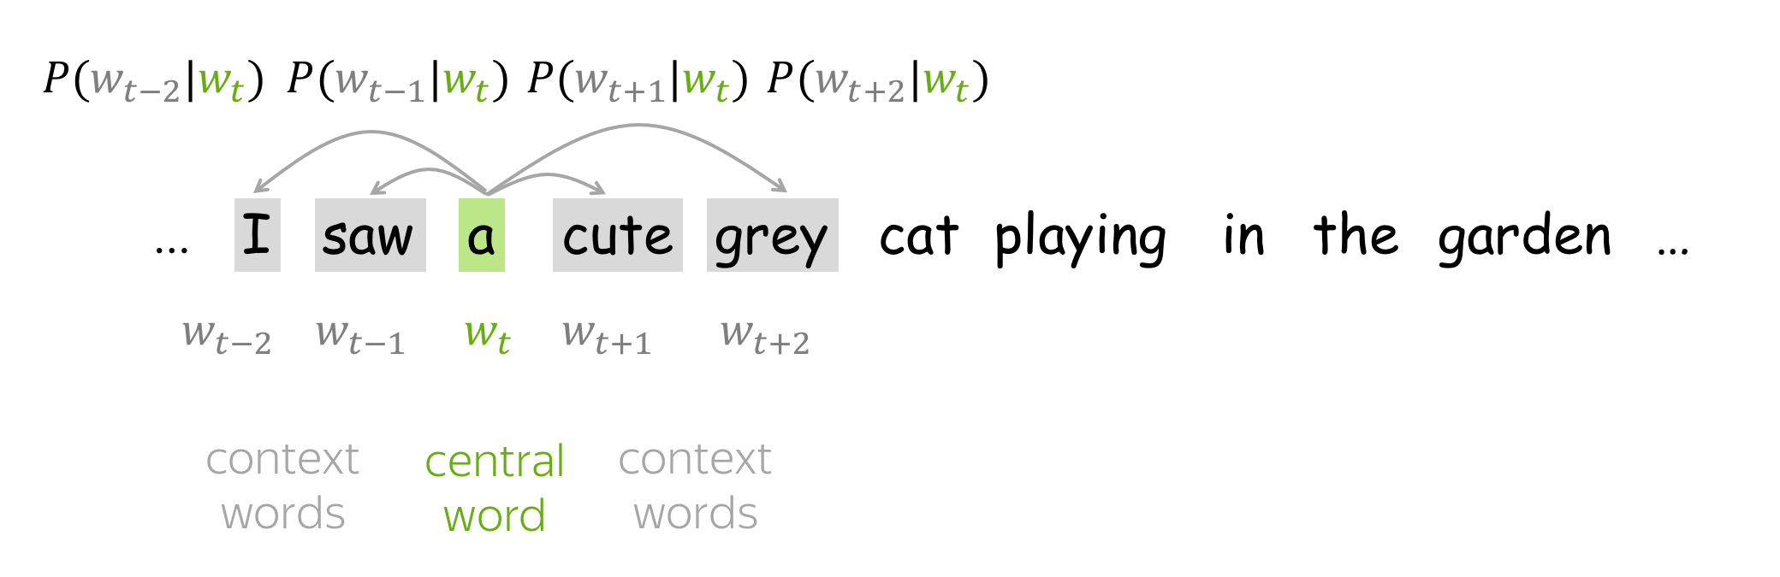
WORD2VEC
Word2Vec
Algorithm steps (toy explanation)
https://lena-voita.github.io/nlp_course/word_embeddings.html

Slide 60
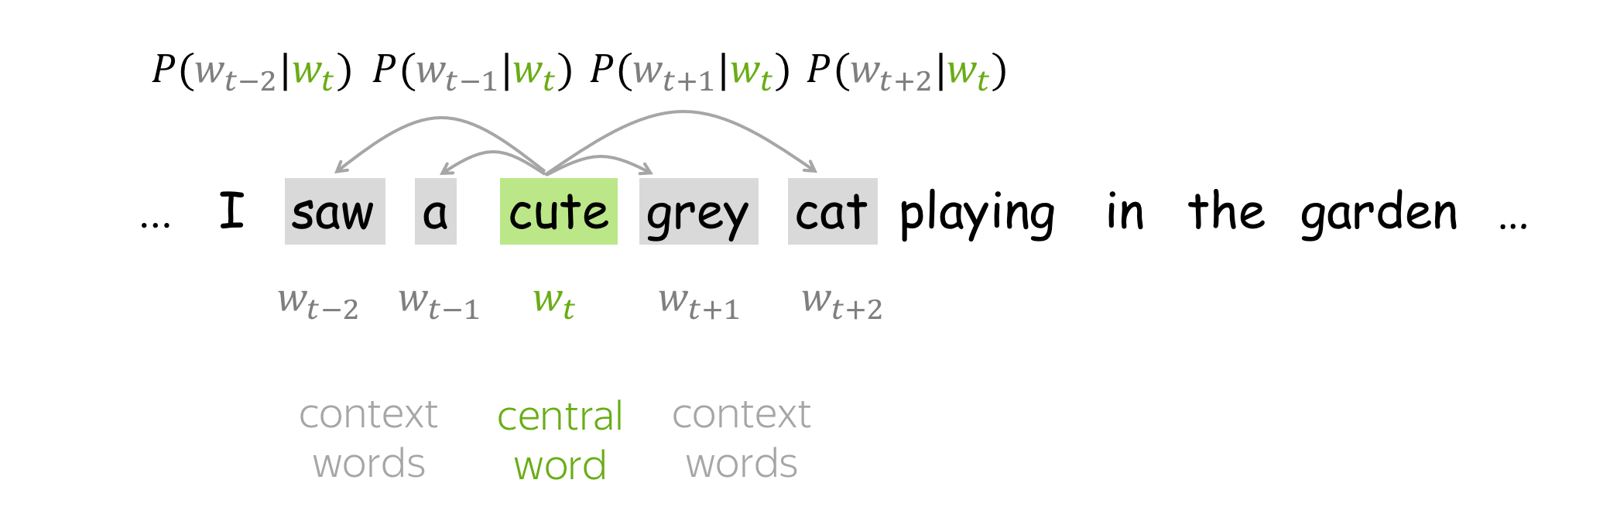
WORD2VEC
Word2Vec
Algorithm steps (toy explanation)
https://lena-voita.github.io/nlp_course/word_embeddings.html

Slide 61
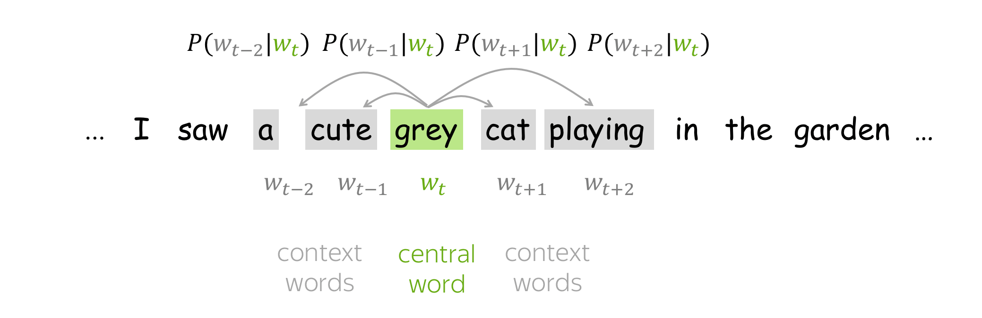
WORD2VEC
Word2Vec
Algorithm steps (toy explanation)
https://lena-voita.github.io/nlp_course/word_embeddings.html

Slide 62
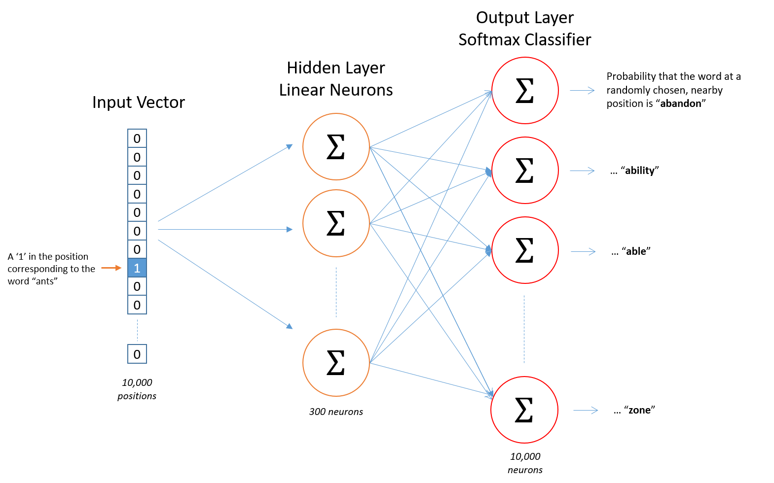
WORD2VEC
Word2Vec
General architecture
http://mccormickml.com/2016/04/19/word2vec-tutorial-the-skip-gram-model/

Slide 63
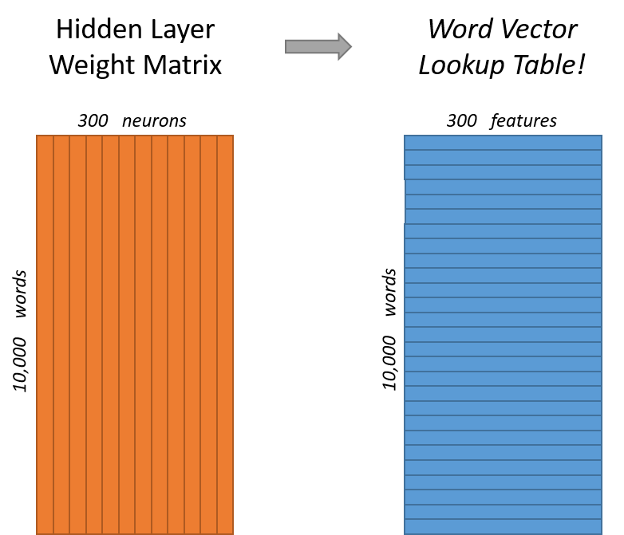
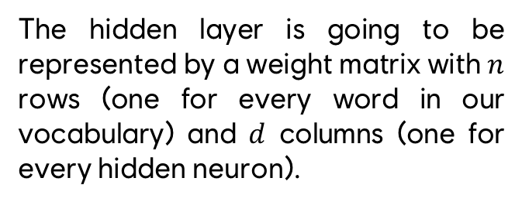
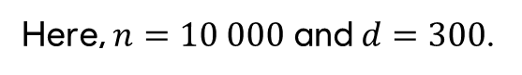
WORD2VEC
Word2Vec
General architecture
The hidden layer is going to be represented by a weight matrix with $n$ rows (one for every word in our vocabulary) and $d$ columns (one for every hidden neuron).
Here, $n=10 000$ and $d=300$.
http://mccormickml.com/2016/04/19/word2vec-tutorial-the-skip-gram-model/

Slide 64
WORD2VEC
Word2Vec
General architecture
Each word has two representations: $u_{w}$ when the word is central and $v_{w}$ when the word isn’t.
Usually, central representations are kept at the end of the training while others are discarded.
https://lena-voita.github.io/nlp_course/word_embeddings.html

Slide 65
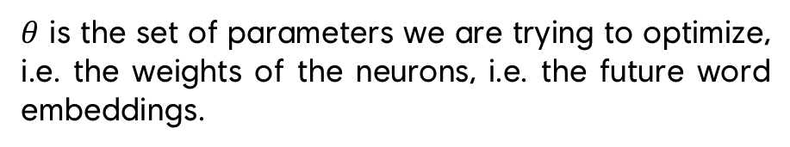
WORD2VEC
Word2Vec
How does it work under the hood?
$θ$ is the set of parameters we are trying to optimize, i.e. the weights of the neurons, i.e. the future word embeddings.
Parameter distribution
Functions measuring how a set of parameters fit the actual observed data.
Likelihood/loss function
Gradient descent is performed one word at a time. It is the process that updates the weights of the network.
Custom gradient descent
There’s no activation function in there because the hidden layer acts as a lookup table rather than a classical hidden layer.
No activation function

Slide 66
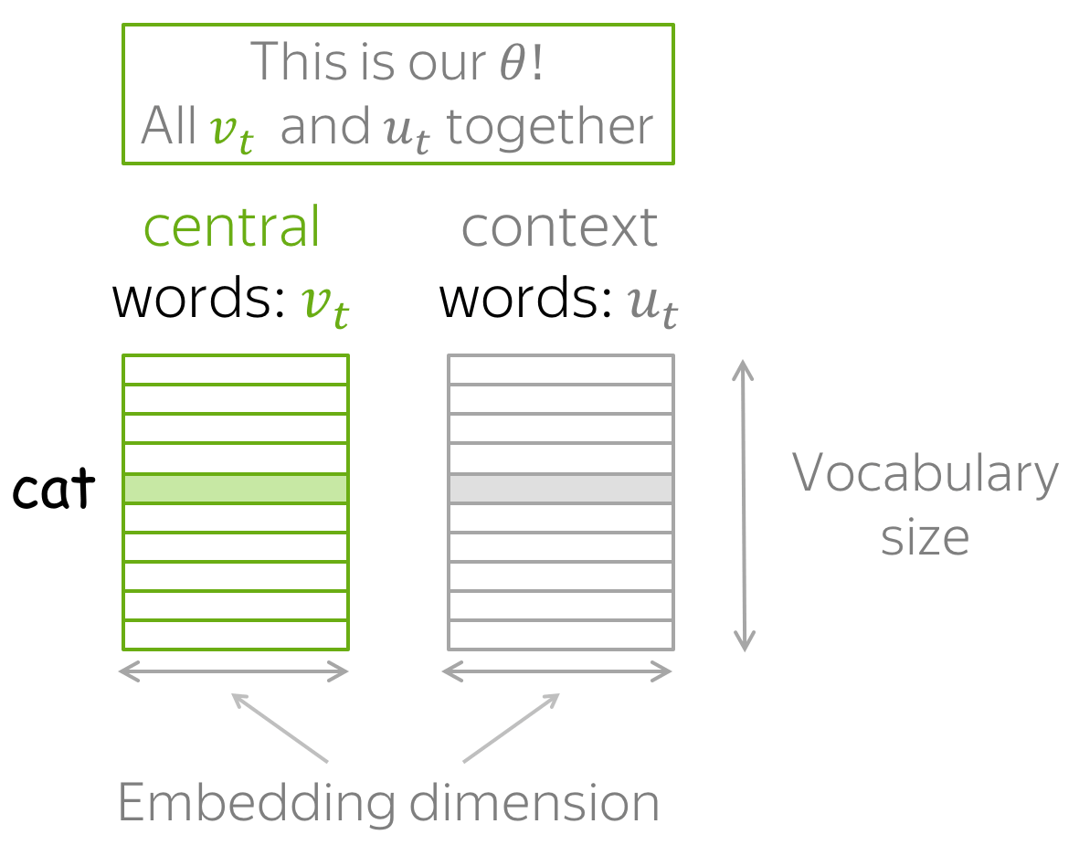
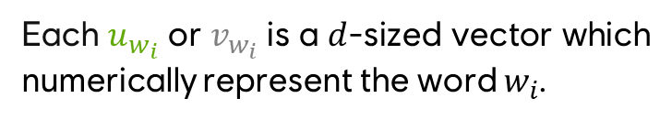
WORD2VEC
Word2Vec
Parameter distribution
Each $u_{w_{i}}$ or $v_{w_{i}}$ is a $d$-sized vector which numerically represent the word $w_{i}$.
We have to optimize the values of those vectors to maximize a specific metric, i.e. our likelihood function.
https://lena-voita.github.io/nlp_course/word_embeddings.html

Slide 67
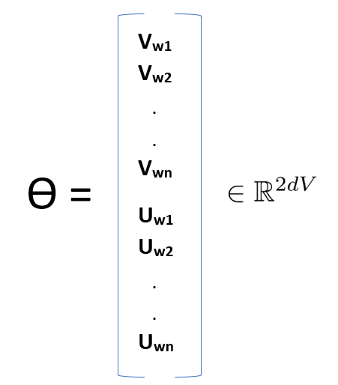
WORD2VEC
Word2Vec
Parameter distribution
Each $u_{w_{i}}$ or $v_{w_{i}}$ is a $d$-sized vector which numerically represent the word $w_{i}$.
We have to optimize the values of those vectors to maximize a specific metric, i.e. our likelihood function.
https://medium.com/analytics-vidhya/maths-behind-word2vec-explained-38d74f32726b

Slide 68
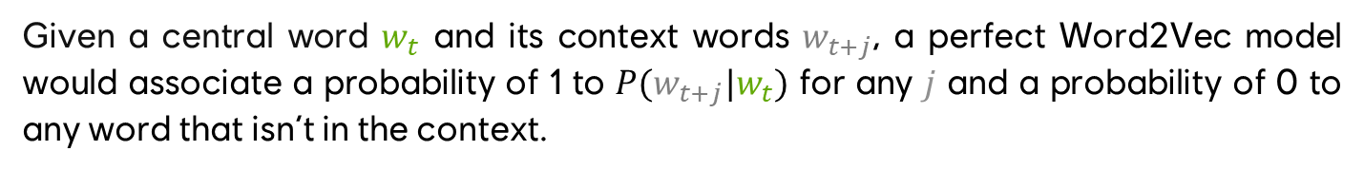
WORD2VEC
Word2Vec
Likelihood function
Given a central word $w_{t}$ and its context words $w_{t+j}$, a perfect Word2Vec model would associate a probability of 1 to $P(w_{t+j}|w_{t})$ for any $j$ and a probability of 0 to any word that isn’t in the context.

Slide 69
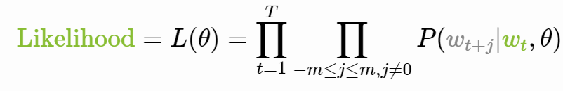
WORD2VEC
Word2Vec
Likelihood function
https://lena-voita.github.io/nlp_course/word_embeddings.html

Slide 70
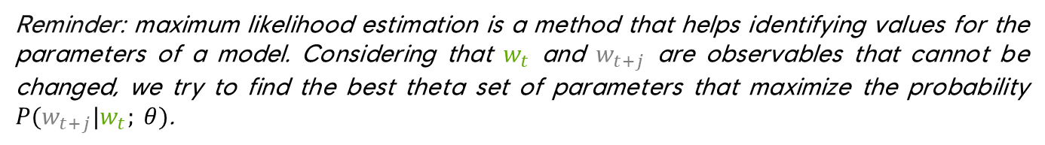
WORD2VEC
Word2Vec
Likelihood function
In this case, the below equation measures how well a given parameter distribution maximize the overall probabilities.
Reminder: maximum likelihood estimation is a method that helps identifying values for the parameters of a model. Considering that $w_{t}$ and $w_{t+j}$ are observables that cannot be changed, we try to find the best theta set of parameters that maximize the probability $P(w_{t+j}|w_{t}; θ)$.
https://lena-voita.github.io/nlp_course/word_embeddings.html

Slide 71
WORD2VEC
Word2Vec
Likelihood function
For each position $t=1,…,T$ in a text corpus, Word2Vec predicts context words within a $m$-sized window given the central word $w_{t}$:
$θ$ refers to the set of variables to optimize, i.e. our word vectors. In the case of Maximum Likelihood Estimation, this is our distribution
https://lena-voita.github.io/nlp_course/word_embeddings.html

Slide 72
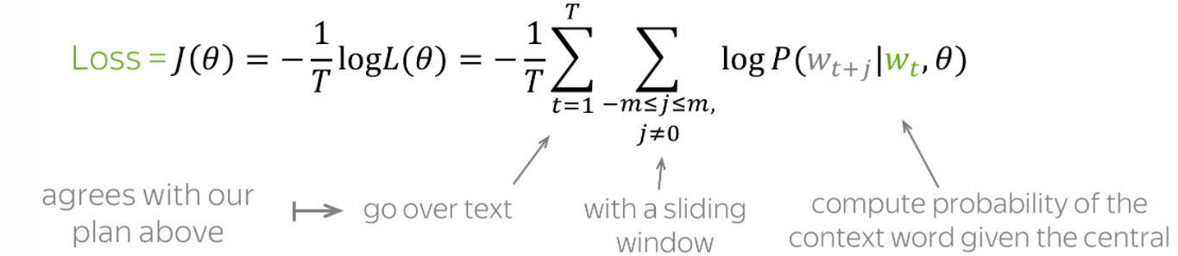
WORD2VEC
Word2Vec
Loss function
Since gradient descent will be used one word at a time to update parameters, we transpose this likelihood function into a loss function to be minimized. This helps because sums are way easier to derivate than products.
https://lena-voita.github.io/nlp_course/word_embeddings.html

Slide 73
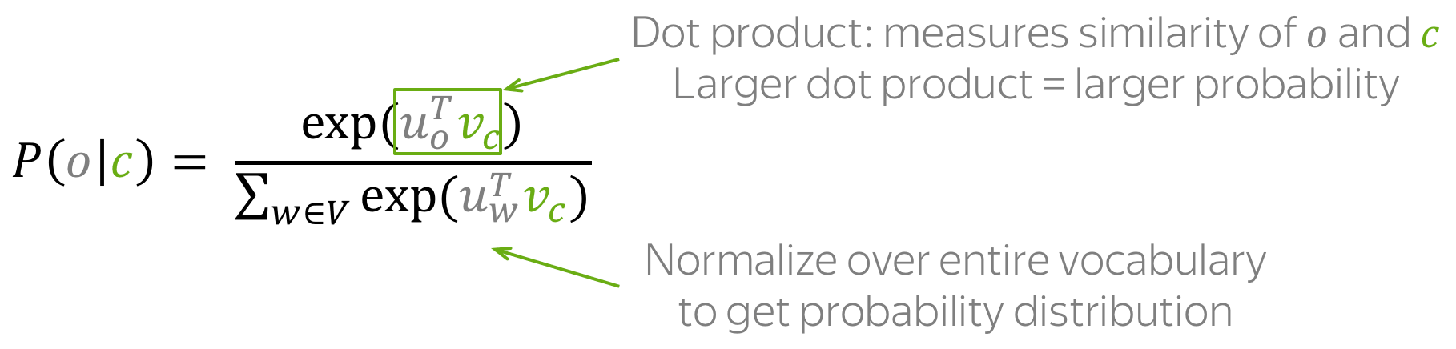
WORD2VEC
Word2Vec
Calculating probabilities
The actual probability of $o$ (context word) being in the window of $c$ (central word) is computed using the following formula:
Note: this is the softmax function!
https://lena-voita.github.io/nlp_course/word_embeddings.html
Notes:
En mathématiques, la fonction softmax, ou fonction exponentielle normalisée, est une généralisation de la fonction logistique qui prend en entrée un vecteur {\displaystyle \mathbf {z} =\left(z_{1},\dots ,z_{K}\right)} de K nombres réels et qui en sort un vecteur {\displaystyle \sigma \left(\mathbf {z} \right)} de K nombres réels strictement positifs et de somme 1.

Slide 74
WORD2VEC
Word2Vec
Gradient descent
The Word2Vec gradient descent is rather standard and rely on the following formula, with $α$ being the learning rate hyperparameter:
$$θ^{new}=θ^{old}−α∇_{θ}J(θ)$$
New parameter
Old parameter
Tiny step in the direction of a local minimum of the loss function
Notes:
If someone struggle with that, use this example:
f ‘(a) est le coefficient directeur de la tangente au point d’abscisse a, pour une courbe et sa tangente. Elle indique la direction à prendre à partir de ce point

Slide 75


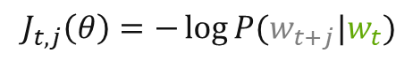
WORD2VEC
Word2Vec
Gradient descent
Contrary to other gradient descent methods, each update is made for a single parameter at a time, i.e. for a single couple of words $(w_{t},w_{t+j})$ at a time.
Looking back at the loss function, we can isolate a distinct term $J_{t, j}(θ)$:
$J\left(θ\right)=−\frac{1}{T}\sum_{t=1}^{T}{\sum_{−m≤j≤m}{\log{P(w_{t},w_{t+j};θ)}}}$
$J\left(θ\right)=\frac{1}{T}\sum_{t=1}^{T}{\sum_{−m≤j≤m}{J_{t, j}\left(θ\right)}}$
$J_{t, j}\left(θ\right)=−\log{P(w_{t+j}|w_{t})}$
https://lena-voita.github.io/nlp_course/word_embeddings.html
Notes:
If someone struggle with that, use this example:
f ‘(a) est le coefficient directeur de la tangente au point d’abscisse a, pour une courbe et sa tangente. Elle indique la direction à prendre à partir de ce point

Slide 76
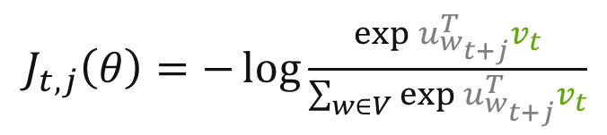
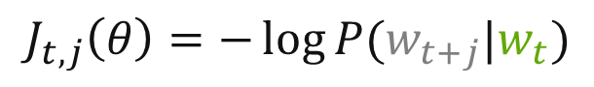
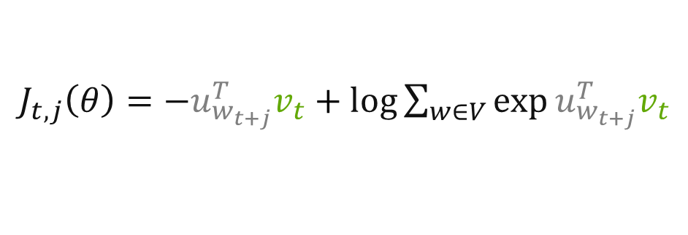
WORD2VEC
Word2Vec
Gradient descent
By unrolling this equation, we get the following:
$J_{t, j}\left(θ\right)=−\log{P(w_{t+j}|w_{t})}$
$J_{t, j}\left(θ\right)=−\log{\frac{\exp{u_{w_{t+j}}^{T}v_{t}}}{\sum_{w∈V}{\exp{u_{w_{t+j}}^{T}v_{t}}}}}$
$J_{t, j}\left(θ\right)=−u_{w_{t+j}}^{T}v_{t}+\log{\sum_{w∈V}{\exp{u_{w_{t+j}}^{T}v_{t}}}}$
https://lena-voita.github.io/nlp_course/word_embeddings.html
Notes:
If someone struggle with that, use this example:
f ‘(a) est le coefficient directeur de la tangente au point d’abscisse a, pour une courbe et sa tangente. Elle indique la direction à prendre à partir de ce point

Slide 77


WORD2VEC
Word2Vec
Gradient descent
Updating the values of $u$ and $v$ in order to minimize $J_{t, j}\left(θ\right)$ increase the similarity between the current central word $v$ and the current considered outside word $u$ while decreasing the similarity between the current central word $v$ and all other words $w$ of the vocabulary.
https://lena-voita.github.io/nlp_course/word_embeddings.html

Slide 78
WORD2VEC
Word2Vec
Gradient descent
By iterating a lot of time over each central word / outside word, the model converges to vectors that have learned the distribution of possible contexts.
Hence, we have our word representations!
https://lena-voita.github.io/nlp_course/word_embeddings.html

Slide 79

WORD2VEC
Word2Vec
Gradient descent
https://lena-voita.github.io/nlp_course/word_embeddings.html

Slide 80
WORD2VEC
2013
Word2Vec
Summary

Slide 81
WORD2VEC
Word2Vec
Summary
The Word2Vec algorithm is similar to previous approaches relying on vanilla neural networks but cleverly twists the behaviour of classical neural networks to efficiently create word embeddings that have strong semantic properties.
This has been achieved by the definition of a new objective task aiming to predict the surrounding context words of a given word.
The single hidden layer that is used as a lookup table for our word vectors makes it extremely fast to train compared to similar methods. Plus, it makes this algorithm suitable to large scale datasets.

Slide 82

Wait… Are word vectors used in modern systems simply obtained from plain neural networks?
Word2Vec is now kind of outdated. It is still a widely used algorithm for a wide range of NLP tasks, but cutting edge systems rely on funkier networks.

Slide 83
Wait… Are word vectors used in modern systems simply obtained from plain neural networks?
Before getting there, lots of trials have been made with various type of networks / architectures. The following list is a glimpse of 5y+ of research capitalizing on the great results obtained by the Word2Vec algorithm.

Slide 84
METHODOLOGIES TIMELINE
1960+
2008
Dummy encoding
Multi-task learning
~1980
2013
TF-IDF
Word2Vec
2001
2013
Vanilla Neural Networks
Beyond plain ANNs

Slide 85

RECURRENT NEURAL NETWORKS
Neural networks with a notion of memory
At each timestep, a « summary » of the previous timestep is fed to the network alongside an actual input. Such summaries are called hidden state or hidden units.
Representation of a vanilla recurrent network
Because the previous state is needed at each step of the computation, recurrent networks are often really long to train.
If you want to know more about such networks, have a look at this great presentation: https://www.youtube.com/watch?v=UNmqTiOnRfg

Slide 86

RECURRENT NEURAL NETWORKS
Neural networks with a notion of memory
At each timestep, a « summary » of the previous timestep is fed to the network alongside an actual input. Such summaries are called hidden state or hidden units.
Because the previous state is needed at each step of the computation, recurrent networks are often really long to train.
Animated representation of a vanilla recurrent network cell

Slide 87

LONG SHORT TERM MEMORY NETWORKS
LSTM are a special kind of recurrent neural network
They introduce many subtles changes dedicated to handle problems of standard RNN
Particularly, LSTM are good at modeling long term memory without losing short term relationships
Internal representation of a LSTM network. Variants, such as bi-directional LSTMs are commonly used

Slide 88

LONG SHORT TERM MEMORY NETWORKS
LSTM are a special kind of recurrent neural network
They introduce many subtles changes dedicated to handle problems of standard RNN
Particularly, LSTM are good at modeling long term memory without losing short term relationships
Animated representation of LSTM cell

Slide 89


LONG SHORT TERM MEMORY NETWORKS

Slide 90

CONVOLUTIONAL NEURAL NETWORKS
Neural networks with a notion of proximity
Each region of the sequence is aggregated with its direct neighbours. This is repeated multiple times across the network layers, and result in features that are directly computed by the system.
Such networks are the keys to all modern computer vision systems, since images really benefit from proximity relationships (close pixels usually represent the same thing)

Slide 91

CONVOLUTIONAL NEURAL NETWORKS

Slide 92

CONVOLUTIONAL NEURAL NETWORKS

Slide 93

CONVOLUTIONAL NEURAL NETWORKS
Character-level CNN for Text Classification (Zhang et al., 2015)

Slide 94

CONVOLUTIONAL NEURAL NETWORKS
Activations of some layers of a CNN

Slide 95

CONVOLUTIONAL NEURAL NETWORKS
First layers of a Character-level CNN for Text Classification, which are WAY less interpretable.

Slide 96
METHODOLOGIES TIMELINE
1960+
2008
2014
Dummy encoding
Multi-task learning
Seq2seq models
~1980
2013
TF-IDF
Word2Vec
2001
2013
Vanilla Neural Networks
Beyond plain ANNs

Slide 97


GENERATING SEQUENCES FROM SEQUENCES
Another Far Cry game?
How many users connected yesterday?
Un autre jeu Far Cry?
Another Far Cry game?

Slide 98

GENERATING SEQUENCES FROM SEQUENCES
Encoder / Decoder - Sequence to sequence system behaviour
https://jalammar.github.io/visualizing-neural-machine-translation-mechanics-of-seq2seq-models-with-attention/

Slide 99


GENERATING SEQUENCES FROM SEQUENCES
Sequence-to-sequence learning systems were proposed in 2014 by Sutskever et al. Those frameworks were designed to map a given sequence $S$ to another sequence $S^{′}$, regardless of the nature of $S$ and $S′$.
Sequence-to-sequence systems are composed of two major elements – an encoder and a decoder. As a result, they’re often called Encoder/Decoder networks.
The encoder network process the sequence $S$ symbol by symbol and compress it into a vector representation. After that, the decoder network predicts the output symbol by symbol using the compressed information issued by the encoder.
At each of its step, the decoder takes as an input the previous output it issued as well as the information provided from the encoder.
https://ruder.io/a-review-of-the-recent-history-of-nlp/

Slide 100

GENERATING SEQUENCES FROM SEQUENCES
Encoder / Decoder - Sequence to sequence system architecture
https://jalammar.github.io/visualizing-neural-machine-translation-mechanics-of-seq2seq-models-with-attention/

Slide 101

GENERATING SEQUENCES FROM SEQUENCES
Context vector that is generated by the encoder and leveraged by the decoder.
https://jalammar.github.io/visualizing-neural-machine-translation-mechanics-of-seq2seq-models-with-attention/

Slide 102

GENERATING SEQUENCES FROM SEQUENCES
Encoder / Decoder -Sequence to sequence system internal architecture
https://jalammar.github.io/visualizing-neural-machine-translation-mechanics-of-seq2seq-models-with-attention/

Slide 103

GENERATING SEQUENCES FROM SEQUENCES
Encoder / Decoder -Sequence to sequence system internal architecture
https://jalammar.github.io/visualizing-neural-machine-translation-mechanics-of-seq2seq-models-with-attention/

Slide 104
METHODOLOGIES TIMELINE
1960+
2008
2014
Dummy encoding
Multi-task learning
Seq2seq models
~1980
2013
2015
TF-IDF
Word2Vec
Attention
2001
2013
Vanilla Neural Networks
Beyond plain ANNs

Slide 105
ATTENTION
Sequence-to-sequence learning systems presented earlier presented a massive problem despite their great overall performances: they failed at handling long sequences efficiently.
This was solved by Bahdanau et al. in 2014 and Luong et al. in 2015 by the introduction of a mechanism called attention. As its name indicates, this mechanism provides a way to identify which part of the context is important at a given timestep instead of looking at it as a whole.

Slide 106

ATTENTION
Sequence to sequence system with attention mechanism
https://jalammar.github.io/visualizing-neural-machine-translation-mechanics-of-seq2seq-models-with-attention/

Slide 107
ATTENTION
This mechanism relies on two major twists compared to standard sequence to sequence systems.
First, the decoder send multiple context vectors to the decoder instead of one. The motivation of this modification is that decoding long sentences is hard when everything related to this sentence is compressed in a single representation. Instead, having multiple representations of chunk of sentences would help the system to pay attention the the actual chunk he needs at a specific timestep. That’s why it’s called attention!

Slide 108

ATTENTION
https://jalammar.github.io/visualizing-neural-machine-translation-mechanics-of-seq2seq-models-with-attention/

Slide 109
ATTENTION
This mechanism relies on two major twists compared to standard sequence to sequence systems.
First, the decoder send multiple context vectors to the decoder instead of one. The motivation of this modification is that decoding long sentences is hard when everything related to this sentence is compressed in a single representation. Instead, having multiple representations of chunk of sentences would help the system to pay attention the the actual chunk he needs at a specific timestep. That’s why it’s called attention!
Second, the decoder performs an extra step before predicting an output. It scores each context vector independantly at each timestep and create a synthezised new context vector for the given timestep.

Slide 110

ATTENTION
https://jalammar.github.io/visualizing-neural-machine-translation-mechanics-of-seq2seq-models-with-attention/

Slide 111

ATTENTION
https://jalammar.github.io/visualizing-neural-machine-translation-mechanics-of-seq2seq-models-with-attention/

Slide 112

ATTENTION
Applied to text, this mechanism helps the system to look at the relevant part of the input text it needs upon prediction of the next symbol of the output sequence.
Attention paid to specific parts of the input at each output symbol prediction.
https://jalammar.github.io/visualizing-neural-machine-translation-mechanics-of-seq2seq-models-with-attention/

Slide 113
METHODOLOGIES TIMELINE
1960+
2008
2014
Dummy encoding
Multi-task learning
Seq2seq models
~1980
2013
2015
TF-IDF
Word2Vec
Attention
2001
2013
2016
Vanilla Neural Networks
Beyond plain ANNs
Augmented memory-based models

Slide 114
AUGMENTED MEMORY-BASED MODELS
Attention can be seen as a kind of selective memory – at each timestep, the decoder remembers relevant part of the input. This is just like human behaviour: if you’re asked what you were doing last Saturday evening, the fact that you forgot to empty the trash before leaving your place this morning shouldn’t come to your mind.
Attention proved to be the most efficient way to look at specific parts of the input at a given decoder timestep. However, other models have been studied to do that; most of them include an external memory that is shared between all timesteps and constantly updated.
https://distill.pub/2016/augmented-rnns/#neural-turing-machines

Slide 115

AUGMENTED MEMORY-BASED MODELS
https://distill.pub/2016/augmented-rnns/#neural-turing-machines

Slide 116

METHODOLOGIES TIMELINE
The state of the art has kept moving drastically fast since
2018
Pretrained language models

Slide 117

PRETRAINED LANGUAGE MODELS
Transfer learning
Transfer learning is the process of reusing parts of a source network $A$ already trained on a given task $T$ to ease the training of a target network $B$ trained on a task $T′$ related to $T$. Target network will update this knowledge during its training.
Training a system to walk and reusing the learnt information to train another system to run rather than learning to run from scratch is a good example of transfer learning.
In the case of text representation, are word embeddings an example of transfer learning?

Slide 118


PRETRAINED LANGUAGE MODELS
Transfer learning
Generally, the first layers of a neural network tend to extract features from the observed data and the last layers tend to handle decision making.
As a result, reusing the first layers from a trained source network $A$ (i.e. the layers architecture and their weights) as the first layers of a target network $B$ will enable the target network $B$ to reuse the knowledge learned from $A$ and to update it based on the target task needs.
Transfer learning – first layers of ImageNet being transfered to another system after being trained.

Slide 119
PRETRAINED LANGUAGE MODELS
Transfer learning in NLP
The use of previously-learned word embeddings proved to improve a lot of NLP tasks, ranging from Natural Language Inference to Sentiment Analysis.
However, they have an inherent problem that prevented from obtaining better results – they were context-agnostic, i.e. that they can’t easily handle polysemy.
For the record, they aren’t an actual example of transfer learning. They are simply used to represent words efficiently given as an input. However, a target system could never update the representations used.

Slide 120

PRETRAINED LANGUAGE MODELS
Language models
In NLP, lower-level layers seem to capture semantic while higher-level layers seem to capture context. As a result, we often plug the whole layers of a trained source system $A$ as the input of a target system $B$, apart from the very last layer of network $A$ which is often a softmax.
Source networks trained on large corpora of texts and later reused as pluggable and updatable transfer learning networks are called Language models.
The use of pretrained language models have proven to outperform every other methods by 10% on more than 13 NLP tasks.

Slide 121
PRETRAINED LANGUAGE MODELS
Language models
Many language models have been developed in the last two years (2018-2020). Their goal is the same, but they differ in the philosophy, the primary task(s) used to train the network and the architecture they rely on.

Slide 122

PRETRAINED LANGUAGE MODELS
Improvements with language model embeddings over the state-of-the-art (Peters et al., 2018)

Slide 123
Key takeaways
Text transformation into meaningful numerical vectors is at the core of all NLP tasks. Models enabling such conversion have been studied for quite a long time, but their rise have followed the rise of internet.
Multiple approaches have been studied, including recurrent networks and generative models.
In the last few years, transfer learning has shown its efficiency in NLP: more than 10 NLP benchmark have been improved just by using this technique.

Slide 124
PART 3 LANGUAGE MODELS

Slide 125

MODEL SIZE EVOLUTION

Slide 126

MODEL SIZE EVOLUTION

Slide 127

MODEL SIZE EVOLUTION

Slide 128

MODEL CONTEXT SIZE EVOLUTION

Slide 129

PERFORMANCES EVOLUTION
https://informationisbeautiful.net/visualizations/the-rise-of-generative-ai-large-language-models-llms-like-chatgpt/

Slide 130

ELMo
Context matters

Slide 131
ELMo
Philosophy
Instead of using a fixed embedding for each word, ELMo looks at the entire sentence before assigning an embedding to each word.
Solves the problem of polysemy!

Slide 132
ELMo
Primary task(s)
Anyone!
ELMo is to be added on top of our target network and doesn’t support pre-trained weights per se.
Instead, it consists in an architecture that can be added on top of any target network to compute word embeddings that are flexible to the context in which they are used.

Slide 133
ELMo
Architecture
ELMo relies on two main elements:
1. The use of a character-level CNN to represent words into raw vectors
2. The use of bi-directional LSTMs to extract intermediate word representations

Slide 134

ELMo
Architecture
In this architecture, the representation coming from the character level CNN are fed as input to the bi-directional LSTMs (bi-LSTMs).
The forward pass contains information about a word and everything before it.
The backward pass contains information about a word and everything after it.
https://www.analyticsvidhya.com/blog/2019/03/learn-to-use-elmo-to-extract-features-from-text/#:~:text=ELMo%20is%20a%20novel%20way,as%20well%20as%20the%20industry.

Slide 135
ELMo
Architecture
As a result, each word has two representation synthetizing respectively prior and posterior words of a sentence.
The final representation of words are the weighted sum of raw word vectors from the CNN and the 2 intermediate word vectors resulting from the two bi-directional LSTMs.
https://www.analyticsvidhya.com/blog/2019/03/learn-to-use-elmo-to-extract-features-from-text/#:~:text=ELMo%20is%20a%20novel%20way,as%20well%20as%20the%20industry.

Slide 136
ELMo
Results
Word embeddings that are aware of the context they were used in, because their representation integrates those of the words that came before or come after.
For instance, such a system will have no trouble in differentiating a mouse (animal) and a mouse (keyboard).

Slide 137
ELMo
Note
This model is shallow bi-directional since representations aren’t jointly conditioned on both left and right context in all layers.

Slide 138
THE TRANSFORMER

Slide 139
THE TRANSFORMER
What is “The Transformer”?
A model introduced in 2017 based on self-attention that tackles some problems of LSTMs, such as the lack of parallelization due to their linear structure as well as their difficulty to model long and short range dependencies.

Slide 140
THE TRANSFORMER
Philosophy
The lack of parallelization in LSTMs is due to their linear nature – they must see an element after the other to capture their actual order.
How to encode the position of the word in the sentence directly in its representation to enable parallelization?

Slide 141
THE TRANSFORMER
Primary task(s)
Predicting the next word of a sentence.
Yes. Again.

Slide 142
THE TRANSFORMER
Architecture
Stacked encoders / decoders powered by a positional encoding mechanism.
Each encoder or decoder block can be stacked multiple times, according to the complexity of the underlying target task.
Introduce a mechanism of self-attention.

Slide 143

THE TRANSFORMER
Architecture
Transformer architecture – an input is given to a stack of encoders and decoded by a stack of decoders
http://jalammar.github.io/illustrated-transformer/

Slide 144

THE TRANSFORMER
Architecture
All encoders share the same architecture, yet they don’t share their weights.
It is the same for the decoders.
Transformer architecture – an input is given to a stack of encoders and decoded by a stack of decoders
http://jalammar.github.io/illustrated-transformer/

Slide 145

THE TRANSFORMER
Architecture
Each encoder is composed of two elements: a feed forward network and a self-attention layer. The self-attention is similar to the attention mechanism introduced earlier and indicates to the encoder which part of the input it should actually encode.
Decoders share the same principle, yet they have another layer in-between the self-attention and the feed-forward. This layer is called the encoder-decoder attention. It helps the decoder focus on the relevant part of the input sequence, i.e. the encoder context.
Transformer architecture – detail of encoders and decoders
http://jalammar.github.io/illustrated-transformer/

Slide 146

THE TRANSFORMER
Architecture
Encoder system
Decoder system

Slide 147
THE TRANSFORMER
Architecture
The input and the output (target sentences) are first embedded in a n-dimensional space.
This can be done randomly or initialized from previously trained word embeddings.

Slide 148



THE TRANSFORMER
Architecture
Word embeddings given as an input are $n$-dimensional vectors that have their position encoded in the sentence included in them. We’ll represent them like this from now on:
However, those embeddings are only fed to the first encoder of the stack. After that, the output of each encoder is given as the input of the next one.
Transformer architecture - Input being processed in an encoder
http://jalammar.github.io/illustrated-transformer/

Slide 149
THE TRANSFORMER
Architecture
There’s absolutely no CNN nor RNN in the architecture, hence there’s no way to get a grasp of word positions during training.
Solved by the introduction of positional encoding.

Slide 150

THE TRANSFORMER
Positional encoding
Positional encoding’s goal is to add information of the word position in the sentence to the embedding vector without altering it too much.
As a result, it has to modify the actual word embedding by summing a positional embedding vector to it.
Positional encoding integrates the position of a word inside its embedding
http://jalammar.github.io/illustrated-transformer/

Slide 151


THE TRANSFORMER
Positional encoding
Given a position $pos$, its index $i$ in the embedding dimension and the dimensional size of the vector we’re working with $d_{model}$, the positional encodings are obtained using the following:

Slide 152

THE TRANSFORMER
Positional encoding
As a result, previous word embeddings are upgraded by being summed to positional encoding vectors:

Slide 153

THE TRANSFORMER
Positional encoding
Positional encoding values for different token positions

Slide 154
THE TRANSFORMER
Self-attention
Similarly to attention, self-attention helps the encoders to identify the relevant part of the input they should encode.
The first step of this mechanism is to create three vectors for each of the encoder’s input vector.
Those vectors are called a Query vector, a Key vector and a Value vector.

Slide 155

THE TRANSFORMER
Self-attention
All vectors needed for the self-attention mechanism
http://jalammar.github.io/illustrated-transformer/

Slide 156


THE TRANSFORMER
Self-attention
Those vectors are directly linked to matrices $W^{Q}$, $W^{K}$ and $W^{V}$. In fact, each vector is obtained by computing the dot product between the input vector (the embedding) and one of these matrices.
For instance, multiplying $x1$ by $W^{K}$ gives the key vector $k_{1}$.
All vectors needed for the self-attention mechanism
http://jalammar.github.io/illustrated-transformer/

Slide 157
THE TRANSFORMER
Self-attention
Now, what are the query, key and value vectors?
They are abstractions that are useful to efficiently focus on relevant part of the input without having its position hard-encoded. We’ll explain their role a bit later on.
http://jalammar.github.io/illustrated-transformer/
Notes:
The key/value/query concepts come from retrieval systems. For example, when you type a query to search for some video on Youtube, the search engine will map your query against a set of keys (video title, description, etc.) associated with candidate videos in the database, then present you the best matched videos (values).

Slide 158

THE TRANSFORMER
Self-attention
The first step of the computation of self-attention is to score each input word to identify which ones are the most important at this step.
This score is the dot product $q_{1}∙k_{1}$
http://jalammar.github.io/illustrated-transformer/

Slide 159



THE TRANSFORMER
Self-attention
Then, the scores are divided to have more stable gradients, generally by the square root of the dimensional space.
After that, we multiply each value vector $v_{i}$ by the softmax value of the score.
Finally, we sum all the weigthed value vectors to produce an output attention aware vector $z_{i}$.

Slide 160

THE TRANSFORMER
Self-attention
The different matrices we’ve talked about are a set of parameters that has to be learnt by the model. Each of them is independent from one encoder to the other.
http://jalammar.github.io/illustrated-transformer/

Slide 161
THE TRANSFORMER
Self-attention
The different matrices we’ve talked about are a set of parameters that has to be learnt by the model. Each of them is independent from one encoder to the other.
http://jalammar.github.io/illustrated-transformer/

Slide 162

THE TRANSFORMER
Self-attention
Decoders have another variant of this solution: multi-headed attention. This can be seen as the same process being parallelized multiple times with different initialization for the $W$ matrices.
It modifies the self-attention sub-layer in the decoder stack to prevent positions from attending to subsequent positions
http://jalammar.github.io/illustrated-transformer/

Slide 163

THE TRANSFORMER
Self-attention
This masking, combined with fact that the output embeddings are offset by one position, ensures that the predictions for position $i$ can depend only on the known outputs at positions less than $i$
http://jalammar.github.io/illustrated-transformer/

Slide 164

THE TRANSFORMER
Self-attention
http://jalammar.github.io/illustrated-transformer/

Slide 165
THE TRANSFORMER
Results
Language model (resulting from the encoder stack) that deals with dependencies efficiently in both computing time and performances

Slide 166
BERT
Classifier

Slide 167
BERT
Primary task(s)
Predicting masked words in the input sentence
Predicting whether two input sentences are likely to occur together

Slide 168

BERT
Architecture
BERT is basically a huge stack of Transformer encoders. Each encoder has more attention heads than in the typical Transformer architecture, and the FNN is also bigger.
As a matter of fact, BERT isn’t designed to perform sequence to sequence generation. Hence, it doesn’t have any decoder in it.
http://jalammar.github.io/illustrated-bert/

Slide 169

BERT
Architecture
BERT language modeling first task masks 15% of words in the input and asks the model to predict the missing words.
http://jalammar.github.io/illustrated-bert/

Slide 170

BERT
Architecture
BERT language modeling second task is a binary sentence classification, aiming to know whether two sentences are meant to be juxtaposed or not.
http://jalammar.github.io/illustrated-bert/

Slide 171

BERT
Model input
BERT has a specific kind of input and introduces some preprocessing specificities. It adds a [CLS] token at the beginning of the sentence and a [SEP] token at the end. Those tokens are mainly used for the pair sentence classification.
http://jalammar.github.io/illustrated-bert/

Slide 172


BERT
Model output
Each position outputs a vector of size $hidden_size$. For the sentence classification task, the FNN only focus on the [CLS] token!
http://jalammar.github.io/illustrated-bert/

Slide 173

BERT
Feature extraction
Just like other systems we introduced, we can extract word embeddings from this system. Such word embeddings are contextualized, just like for ELMo.
However, multiple embeddings are available ; which one should we use?
http://jalammar.github.io/illustrated-bert/

Slide 174

BERT
Feature extraction
The best results using a pre-trained BERT model reach a F1-score of 96.1 by concataining the four last layers of the model.
For comparison, a BERT model completely trained on the same task obtained a F1-score of 96.4.
http://jalammar.github.io/illustrated-bert/

Slide 175
BERT
BERT
Feature extraction
New research such as RoBERTa (Robustly Optimized BERT approach) propose new kinds of aggregation that are even more efficient.
http://jalammar.github.io/illustrated-bert/

Slide 176
BERT
Results
A truly bi-directional language model that has great parallelization capabilities and excellent perfomances on more than 10 different NLP tasks.

Slide 177
BERT
Resources
BERT-like models are probably the most used language models used for classification tasks at the moment.
If you want to get your hands on it, feel free to try out the BERT fine-tuning notebook hosted by google, that is fueled by cloud TPUs. It’s free up to an extent!
https://colab.research.google.com/github/tensorflow/tpu/blob/master/tools/colab/bert_finetuning_with_cloud_tpus.ipynb
http://jalammar.github.io/illustrated-bert/

Slide 178
BERT
Resources
So far, we considered that our models we purposefully kept out of the discussion
https://colab.research.google.com/github/tensorflow/tpu/blob/master/tools/colab/bert_finetuning_with_cloud_tpus.ipynb
http://jalammar.github.io/illustrated-bert/

Slide 179
GPT
Generative model, a.k.a. LLMs

Slide 180
GPT
Primary task(s)
Predicting the next word of a sentence.
Yes. Again. AGAIN.

Slide 181

GPT
Architecture
Similarly to BERT, the initial GPT model architecture is a subset of the Transformer architecture. Specifically, it is a stack of decoders.
https://jalammar.github.io/illustrated-gpt2/

Slide 182

GPT
Architecture
The goal of the GPT model was to generate coherent text by predicting the next token in a sequence. To achieve this, it employed a causal (masked) self-attention mechanism, which restricts each token to attend only to preceding tokens in the sequence.
https://jalammar.github.io/illustrated-gpt2/

Slide 183

GPT
Architecture

Slide 184

GPT
Autoregressive model

Slide 185

GPT – Output token sampling
The GPT model generates its output one token at a time. At each timestep, it produces a vector corresponding to the size of the model’s vocabulary, assigning a probability to each token.
There are multiple sampling strategies that determine how tokens are selected, controlled by specific parameters.
https://jalammar.github.io/illustrated-gpt2/

Slide 186


Temperature: Controls randomness; lower values make output more deterministic, higher values increase diversity.
Top‑p (nucleus sampling): Considers only the smallest set of tokens whose cumulative probability exceeds ppp.
Top‑k: Limits selection to the top kkk most probable tokens at each timestep.
GPT – Output token sampling
The most commonly used parameters are:
Temperature: controls randomness; lower values make output more deterministic, higher values increase diversity.
Top‑p: considers only the smallest set of tokens whose cumulative probability exceeds a threshold $p$.
https://www.statology.org/understanding-sampling-methods-llms-temperature-top-k-explained/

Slide 187


Temperature: Controls randomness; lower values make output more deterministic, higher values increase diversity.
Top‑p (nucleus sampling): Considers only the smallest set of tokens whose cumulative probability exceeds ppp.
Top‑k: Limits selection to the top kkk most probable tokens at each timestep.
GPT – Output token sampling
The most commonly used parameters are:
Top‑k: Limits selection to the top $k$ most probable tokens at each timestep.
https://www.statology.org/understanding-sampling-methods-llms-temperature-top-k-explained/

Slide 188
GPT
Results
An autoregressive language model that generates text one token at a time, designed for text generation tasks.
Unlike BERT, which is a bidirectional model optimized for understanding and representation tasks, GPT focuses on generating coherent sequences.

Slide 189
So… That’s it? The LLMs we use are just next token predictors, and they somehow learnt to follow instruction by themselves?
Not really. While the release of GPT2 “solved” the task of generating coherent text, its capability to follow instructions was rather limited.
The key paradigm shift came from a model called InstructGPT that was the first one purpose-built to follow instructions, specifically through the use of reinforcement learning.

Slide 190

FINETUNING LLMs
https://magazine.sebastianraschka.com/p/the-big-llm-architecture-comparison

Slide 191

LLM ARCHITECTURES

Slide 192

LLM ARCHITECTURES
https://magazine.sebastianraschka.com/p/the-big-llm-architecture-comparison

Slide 193
Section key takeaways
NLP field is evolving fast, and almost every modern system rely on deep learning.
The Transformer architecture, while being challenged by alternative ones (e.g. Mamba) remain one of the most performing architecture in the field.
Generative models, mostly decoders, have also taken the world by storm since ~2020 due to their capacity to follow instructions, thanks to the usage of RL in their training.

Slide 194
Section key takeaways
Working on NLP algorithms / systems require to always stay up-to-date with the latest SOTA systems and being able to understand their limitation / advantages really easily, even more than for other machine learning fields at the moment.
Try to do a thorough review of “what’s new” every 6 months, while keeping track of interesting articles in the meanwhile.
If you do it more frequently, you’ll never produce anything since your systems will change all the time. If you do it less frequently, you risk to have systems that are less performant than competitors’.

Slide 195

PART 4 NLP DATA PIPELINE

Slide 196
NLP DATA PIPELINE
What is a data pipeline?
A data pipeline is a chain of processes that manipulate data in order to make it suitable for a defined final usage.
In machine learning, this chain is often called data preprocessing.
Typical data pipelines for standard numerical value generally include scaling, normalization, ranking, ordinal encoding, etc.

Slide 197
NLP DATA PIPELINE
What is normalization for texts?
How do you create word buckets that represent a single idea?
How do you remove outliers, and what are text outliers?

Slide 198
NLP DATA PIPELINE
Is there a single goto NLP data pipeline?
Sadly, no.
Just like for any ML task, data processing is task specific. For some tasks, you will have almost no preprocessing steps while for others (often frequentist tasks) you’ll end up with loads of steps.
In this section, we’ll introduce a typical Topic Modeling pipeline, since it requires many preprocessing steps that can be used individually in other tasks.

Slide 199

NLP DATA PIPELINE
1. Ensure data quality
This is not at all NLP specific, but ensuring your data quality before entering any data science task will save you tons of time in the long run.
Checking data quality ranges from verifying that there’s no N/A in a dataset to ensuring that you have correct replica setup in case of a power outage, while checking for class imbalance.
Those steps are often overlooked in most data science project, but they ensure that the results you obtain are reliable, replicable and that the system you build will be scalable easily.
5 examples data characterics that can be monitored / assessed in the data engineering process

Slide 200
NLP DATA PIPELINE
2. Filtering texts from unwanted characters
Especially if you get data from web, you'll end up with HTML tags or encoding stuff that you don't need in your texts. Before applying anything to them, you need to get them cleaned up.
&amp23 That\x25s like the stupidest thing I\x25ve heard since 2012, @César René.
In this case, we have removed HTML encoding, twitter @ and the date. This won’t be necessary all the time, you might need to keep the @ if you’re working on tweets for instance!
That’s like the stupidest thing I’ve heard since , César René.

Slide 201
NLP DATA PIPELINE
3. Unify your texts
That’s like the stupidest thing I’ve heard since , César René.
In some cases, you don’t care if a word occurs at the begging of a sentence or at the end of it. As a result, you can decide to remove punctuation, letter capitalization, and accents.
that s like the stupidest thing i ve heard since cesar rene

Slide 202
NLP DATA PIPELINE
4. Convert sentence to lists of words
Some words aren’t necessary for Topic Modeling analyses. Before being able to remove such words, you need to isolate your words, i.e. to convert your sentences to lists of words.
that s like the stupidest thing i ve heard since cesar rene
We’ll explain in another step what is n-gram creation. In some cases, you’d like to perform such preprocessing prior to the conversion to lists of words; it depends on your dataset and your end use case.
[“that”, “s”, “like”, “the”, “stupidest”, “thing”, “i”, “ve”, “heard”, “since”, “cesar”, “rene”]

Slide 203
NLP DATA PIPELINE
5. Remove useless words
Now that you have isolated your words, you can remove those that are useless, such as you, I, the, etc.
[“that”, “s”, “like”, “the”, “stupidest”, “thing”, “i”, “ve”, “heard”, “since”, “cesar”, “rene”]
Two approaches exist for that: use a hard defined list of stopwords or rely on TF-IDF to identify useless words.
[“stupidest”, “thing”, “heard”, “since”, “cesar”, “rene”]
You can, of course, mix the two methods!

Slide 204
NLP DATA PIPELINE
6. N-gram creation
N-gram creation is the combination of words that often occur together into a single word, usually represented like word1_word2_word3. A good example would be New_York_City.
[“stupidest”, “thing”, “heard”, “since”, “cesar”, “rene”]
You can either do this by creating a hard list of n-grams or relying on frequentist methods, such as those implemented in gensim. Try to avoid the first one in the case of a large dataset.
[“stupidest”, “thing”, “heard”, “since”, “cesar_rene”]

Slide 205
NLP DATA PIPELINE
7. Stemming / Lemmatization
In the case of Topic Modeling, you don’t want to “count” running and run separately. Instead, you’d like to aggregate all words related to a same idea under a same word.
[“stupidest”, “thing”, “heard”, “since”, “cesar_rene”]
Stemming cuts words to their minimal root. Lemmatization on the other hand is a bit more complex and regroup words under a common lexical entry that is more representative than the root of the word.
[“stupid”, “thing”, “hear”, “since”, “cesar_rene”]

Slide 206
NLP DATA PIPELINE
8. Part-of-speech tagging
Part-of-speech tagging is the identification of a word role in a sentence, such as noun, adjective or verb.
[“stupidest”, “thing”, “heard”, “since”, “cesar_rene”]
This is generally done at the same time than the stemming / lemmatization step since identifying the role of a word needs its complete form.
[“stupid (adj)”, “thing (noun)”, “heard (verb)”, “since (adv)”, “cesar_rene (noun)”]

Slide 207
NLP DATA PIPELINE
Bonus: BERT preprocessing
BERT preprocessing (which isn’t dedicated to Topic Modeling) have a quite different approach that is specific to the end task it tries to solve and the underlying algorithm.
&amp23 That\x25s like the stupidest thing I\x25ve heard since 2012, @César René.
As you can see, some of the steps we applied on our Topic Modeling pipeline were reused here and new steps have also been introduced (token creation for instance).
[“[CLS]”, “That’s”, “like”, “the”, “stupidest”, “[MASK]”, “I’ve”, “heard”, “since”, “[MASK]”, “@César_rené”, “[SEP]”]
Example of BERT preprocessing

Slide 208
Section key takeaways
Working with texts (or any ordered sequence of meaningful symbols) require to use specific preprocessing steps.
Those steps are tightly tied to the dataset your are using and the final task you are undertaking; developing your own NLP preprocessing package aggregating all the preprocessing steps you’ve created will ease reusing them from a project to another.
Preprocessing steps are also linked to the algorithm you chose (BERT has some specific preprocessing for instance) and the level of interpretability that you aim. Just my two cents, the higher is usually the better, you should run away from black boxes.

Slide 209

PART 5 VISUALIZATION

Slide 210
IMPORTANCE OF DATA VISUALIZATION IN NLP

Slide 211
IMPORTANCE OF DATA VISUALIZATION IN NLP
Data visualization is important in ALL data science projects. It is directly responsible of how we interpret results. Hence, it has a direct effect on how we take decisions. It is important for data scientists to understand the risk that both misinformation or disinformation could represent.
There are a lot of human biases that one should be aware of when building a visualization. For instance, pie charts and word clouds are perfect example of really dangerous visualizations to use because of some of our perception bias.
What does it mean for NLP? Well, we have been representing numerical values for centuries; massively representing texts, however, is quite recent: most (good) representations are ad-hoc.

Slide 212

A WORLD OF BIAS
When dealing with data in general, having a good understanding of human bias is key to provide a reliable results.
Human biases are diverse and should be taken into account at several steps of a data project.
They can affect our perception or the type of decision that we take by over/under interpreting some specific signals.

Slide 213
A WORLD OF BIAS
Dataset creation or selection – Belief bias, Occam’s razor, Selective perception
Model selection – Automation bias, Functional fixedness, Mere-exposure effect
Data visualization – Visual biases, Confirmation bias, Clustering illusion
Presentation – Zero-sum bias, Bandwagon effect, Semmelweis reflex, Worldview backfire effect
Notes:
Mere-exposure effect: effect by which people develop a preference for things because they become familiar with them.
Familiarity backfire effect: effect by which familiarity increases the chances of people accepting information as true.
Overkill backfire effect: effect by which less information and information that is easier to process is more likely to be accepted as true.
Confirmation bias: tendency to search for, interpret, focus on and recall information in a way that confirms one’s preexisting beliefs.
Worldview backfire effect: effect by which facts and counter-arguments to a person’s strongly held beliefs only serve to reinforce those beliefs.
Semmelweis reflex: tendance naturelle à rejeter de nouvelles preuves ou de nouvelles connaissances parce qu'elle va à l'encontre des normes, des croyances ou des paradigmes précédemment établis.

Slide 214
HOW TO PREVENT/LEVERAGE THEM?
Creating a perfect visualization is difficult, especially when you’re trying to highlight multiple things at once. However, one can limit the risk of misinterpretation by paying attention to the following questions:
Is the purpose well-defined? As the purpose dictate the deliverable, it needs to be clearly defined.
Does the content support the purpose? Considering that what’s included is as important as what’s excluded, only the relevant content needs to be included. As a reminder, the content, which is a relationship between the reality and the data must always be de-politicized and a-political.
https://towardsdatascience.com/how-to-prevent-misinformation-in-data-visualization-1521a96e6431

Slide 215
HOW TO PREVENT/LEVERAGE THEM?
Creating a perfect visualization is difficult, especially when you’re trying to highlight multiple things at once. However, one can limit the risk of misinterpretation by paying attention to the following questions:
Does the structure reveal the content? An appropriate structure needs to be used to represent clearly the relationship between the reality and the graphic.
Does the visualization facilitate consumption? The visualization, which is the link between the graphic and the data, must be useful by highlighting what matters and removing the rest.
https://towardsdatascience.com/how-to-prevent-misinformation-in-data-visualization-1521a96e6431

Slide 216

LEVERAGE GESTALT PRINCIPLES
Key gestalt principles

Slide 217

LIMIT VISUAL BIASES
Mach bands. On the left side, five grey bars are ordered from dark to light, with gaps between them. On the right side, the bars have no gap between them. The brightness or luminance of the corresponding bars is the same. However, when the bars touch, the dark areas seem darker and the light areas lighter.
https://socviz.co/lookatdata.html

Slide 218

LIMIT VISUAL BIASES
Searching for the blue circle becomes progressively harder.
https://socviz.co/lookatdata.html

Slide 219

LIMIT VISUAL BIASES
Channels for mapping unordered categorical data, arranged top-to-bottom from more to less effective, after Munzer (2014, 102).

Slide 220

LIMIT VISUAL BIASES
Channels for mapping ordered data (continuous or other quantitative measures), arranged top-to-bottom from more to less effective, after Munzer (2014, 102).

Slide 221

LIMIT VISUAL BIASES
Channels for mapping ordered data (continuous or other quantitative measures), arranged top-to-bottom from more to less effective, after Munzer (2014, 102).

Slide 222

VISUALIZATION TOOLKIT
https://datavizproject.com/

Slide 223

VISUALIZATION TOOLKIT
https://www.data-to-viz.com/caveats.html

Slide 224

NLP DATA VISUALIZATION: TOPICS

Slide 225

NLP DATA VISUALIZATION: TOPICS

Slide 226

NLP DATA VISUALIZATION: TOPICS

Slide 227

NLP DATA VISUALIZATION: TOPICS

Slide 228

NLP DATA VISUALIZATION: TOPICS

Slide 229

NLP DATA VISUALIZATION: TOPICS

Slide 230

NLP DATA VISUALIZATION: TOPICS

Slide 231

NLP DATA VISUALIZATION: TOPICS

Slide 232

NLP DATA VISUALIZATION: TOPICS

Slide 233

NLP DATA VISUALIZATION: TOPICS

Slide 234

NLP DATA VISUALIZATION: TOPICS

Slide 235

NLP DATA VISUALIZATION: TOPICS

Slide 236

NLP DATA VISUALIZATION: SENTIMENT ANANLYSIS

Slide 237

NLP DATA VISUALIZATION: SENTIMENT ANANLYSIS

Slide 238

NLP DATA VISUALIZATION: SENTIMENT ANANLYSIS

Slide 239

NLP DATA VISUALIZATION: SENTIMENT ANANLYSIS

Slide 240

NLP DATA VISUALIZATION: SENTIMENT ANANLYSIS

Slide 241

NLP DATA VISUALIZATION: SENTIMENT ANANLYSIS

Slide 242

NLP DATA VISUALIZATION: SENTIMENT ANANLYSIS

Slide 243


NLP DATA VISUALIZATION: NER

Slide 244






HOW TO BUILD SUCH DATA VISUALIZATION?

Slide 245
Section key takeaways
Building a good data visualization is a complex but necessary process. Human bias must be taken into account to avoid misinformation/disinformation and facilitate the comprehension process of end-users.
Adapting data visualizations to the undertaken task and the target audience is key to leveraging the capabilities of the systems you build.
Each NLP task has its own specific data visualizations. Given its young age, you’ll often have to build your own visualizations from scratch. Building a database of visualizations you encounter is a good way to foster creativity when creating visualizations for upcoming projects.

Slide 246

Resources – Blogs
Machine learning blog with some NLP articles; the RNN effectiveness article is a go-to for understanding RNN for texts.
Andrew Kaparthy’s Blog
http://karpathy.github.io/2015/05/21/rnn-effectiveness/)
Dataviz – Do’s and Dont’s
Blog post from Duke university that highlights the Do’s and Dont’s in data visualization
https://guides.library.duke.edu/datavis/topten
Jay Alammar’s NLP Blog
Great visual of recent NLP Language models with simple yet complete explanations
http://jalammar.github.io/
Lena Voita’s NLP Blog
Detailed explanations of key NLP techniques and algorithms
https://lena-voita.github.io/posts.html
Lilan Weng’s ML Blog
Detailed explanations of various ML techniques, including NLP, Reinforcement Learning, …
https://lilianweng.github.io/lil-log/
Sebastian Ruder NLP Blog
Your general NLP blog and probably one of the most useful NLP Newsletter out there.
https://ruder.io/

Slide 247
Resources - Websites
Dataviz Catalogue
Website listing lots of possible data visualizations with entrypoints by task or datatype
https://datavizcatalogue.com/
Dataviz Project
Website listing lots of possible data visualizations with entrypoints by task or datatype
https://datavizproject.com/
Dataviz Caveats
Website detailing visual caveats related to specific types of graphs
https://www.data-to-viz.com/
Distill.pub
Vulgarization articles dealing with complex ML concepts. Very high quality content
https://distill.pub/
NLP Dataset database
More than 200 NLP datasets with lots of different tasks available
https://datasets.quantumstat.com/
Live benchmark of ML models on various domains, including NLP. All models must have a reproducible codebase to be added here.
Papers with code
https://paperswithcode.com/area/natural-language-processing
The gradient
Vulgarization articles dealing with complex ML concepts. Very high quality content
https://thegradient.pub/

Slide 248
Resources - NLP Librairies
Core NLP
Stanford java package dedicated to NLP annotations system (NER, coreference, etc.)
https://stanfordnlp.github.io/CoreNLP/
Gensim
Topic modeling for human – python library including lot of text preprocessing steps alongside TM methods
https://radimrehurek.com/gensim/
Huggingface
Your one-stop shop for everything related to NLP’s neural network: pretrained models, 10-lines models, …
https://huggingface.co/
Natural Language ToolKit
Suite of text preprocessing for classification, tokenization, stemming, etc. at industrial-scale
https://www.nltk.org/
Spacy
Industrial-strength NLP library, with loads of useful pretrained models
https://spacy.io/

Slide 249
Resources - Tools
Connected papers
Explore connected papers in a visual graph – probably one of the most useful tool for SotA review
https://www.connectedpapers.com/
D3.js
One of the most powerful customizable visualization library, built in javascript
https://d3js.org/
Doccano
Text annotation tool built as a Docker image – your messiah for NLP dataset creation.
https://github.com/doccano/doccano
Plotly
Python, R and JS data visualization library that places interactivity at its core, alongside webapp creation
https://plotly.com/
Streamlit
Python webapp visualization library – create interactive webapps in a few lines of code.
https://www.streamlit.io/
Visdom
A flexible tool for creating, organizing, and sharing visualizations of live, rich data. Supports Python
https://github.com/facebookresearch/visdom
Zotero
Local and remote database of scientific articles you’ve read, with metadata retrieval and citation generation
https://www.zotero.org/

Slide 250

Aaaaaaand, this is it.
THANK YOU!
If you have any inquiries, feel free to reach out to me at:
maxime.sazadaly@ext.esiea.fr
maxime.sazadaly@ubisoft.com

